Slide 1
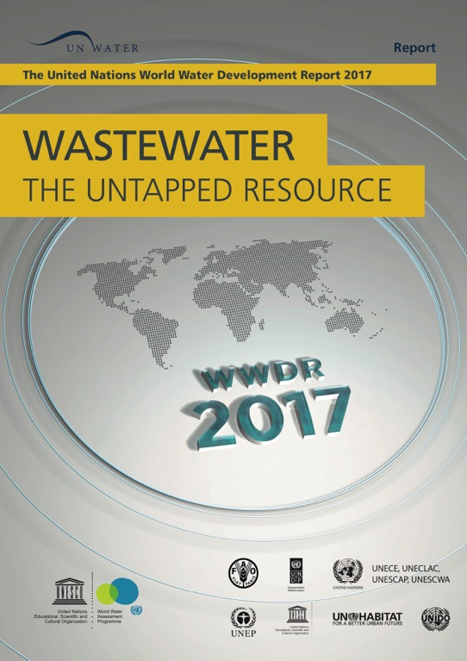
Improved
wastewater management generates social,
environmental and economic benefits essential to achieving sustainable development
Name and Surname
Title and affiliation
Date
Notes:
Title

Slide 2

The state of
The world’s water resources
1
Part
Notes:
Part 1 -title

Slide 3
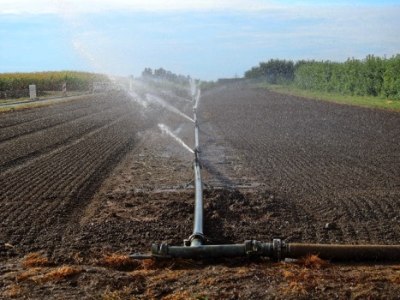
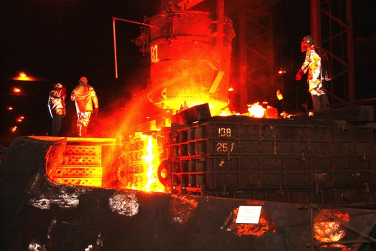
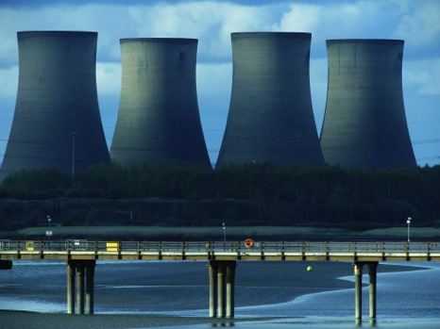
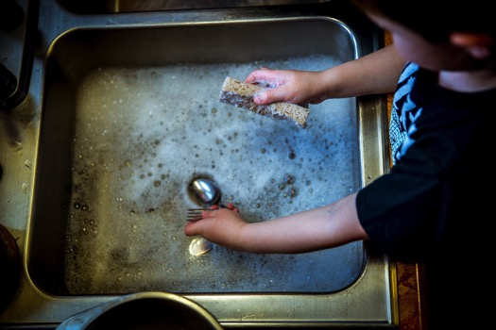
THE DEMAND FOR WATER HAS BEEN CONSISTENTLY INCREASING AND WILL CONTINUE TO DO SO OVER THE COMING DECADES
Notes:
Demand for water..

Slide 4
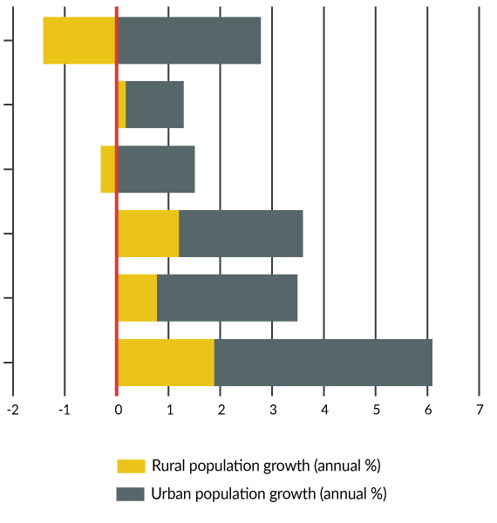
East Asia and Pacific (developing only)
Europe and Central Asia (developing only)
accelerating urbanization
Latin America and Caribbean (developing only)
Middle East and North Africa (developing only)
Additional 2.3 billion people living in cities by 2050
South Asia
Sub-Saharan (developing only)
Source: Based on data from the World Bank (n. d.)
Notes:
Accelerating urbanization

Slide 5
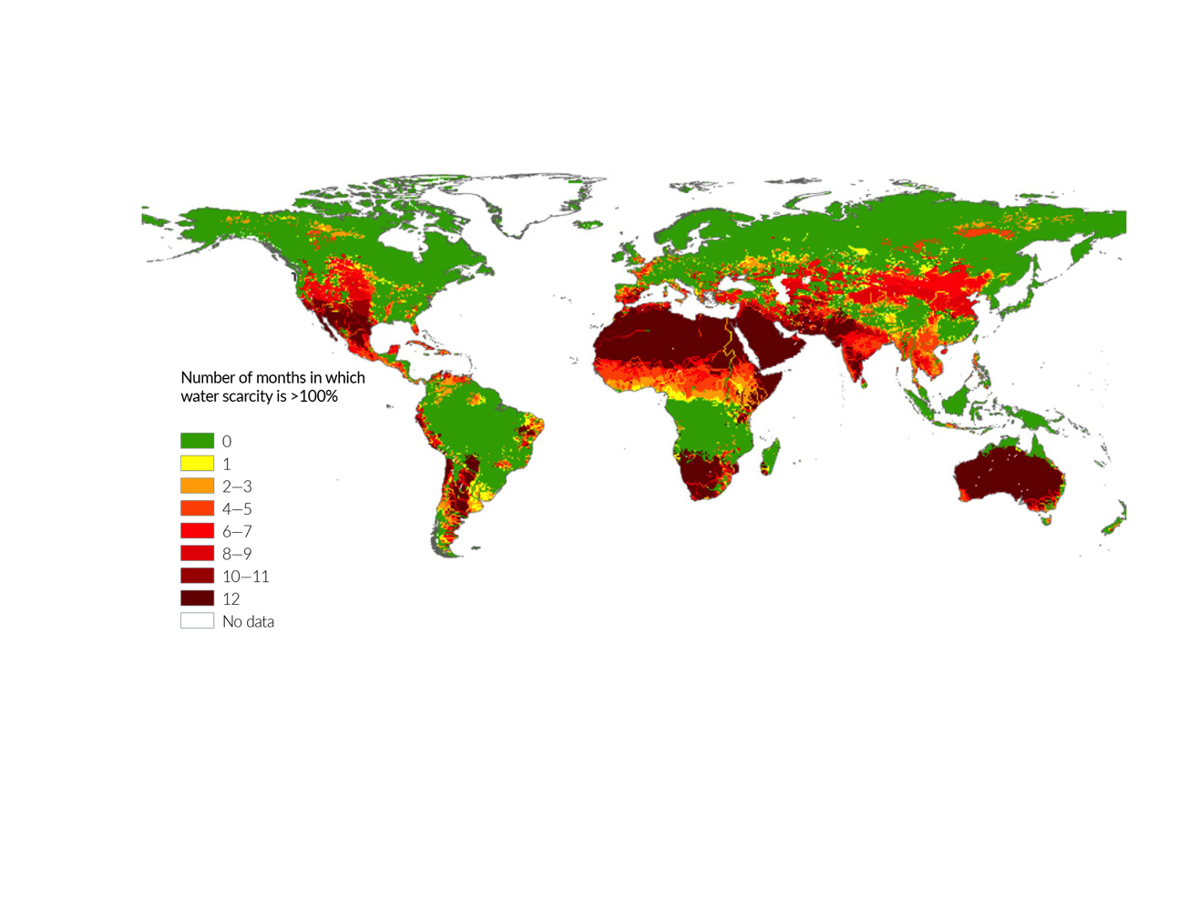
INCREASING WATER
SCARCITY
Two thirds of the world’s population currently live in areas that experience water scarcity for at least one month a year
Source: Mekonnen and Hoekstra (2016)
Notes:
Increasing water scarcity - 1

Slide 6
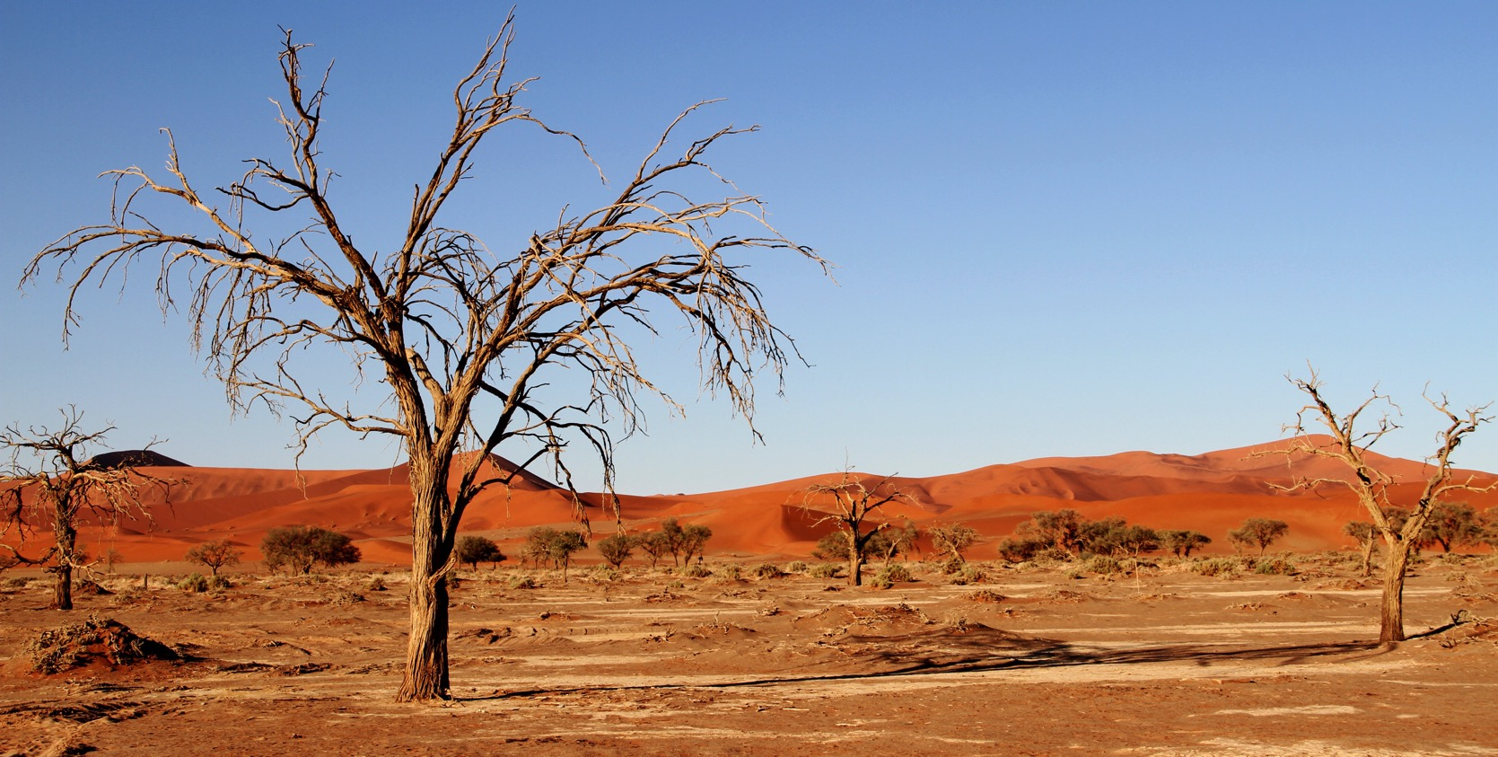
INCREASING WATER
SCARCITY
Climate change will exacerbate the frequency and severity of floods and droughts
Notes:
Increasing water scarcity - 2

Slide 7
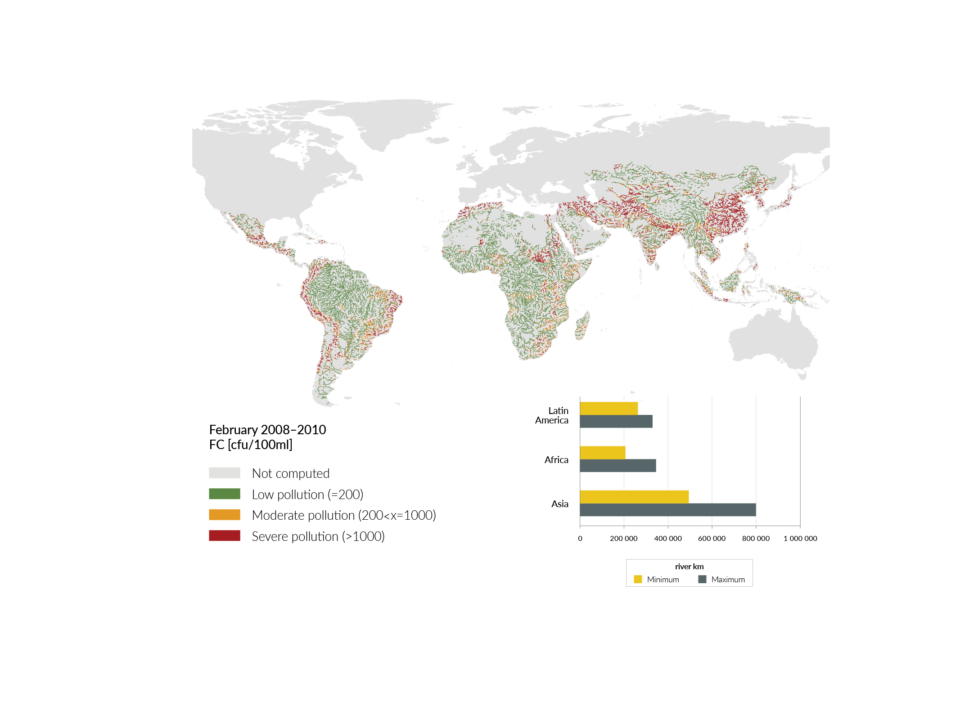
degradation of water quality
Severe pathogen pollution affects around one-third of all river stretches in Latin America, Africa and Asia, putting the health of millions of people at risk
© CESR, University of Kassel, April 2016, WaterGAP3.1
Source: UNEP (2016)
Notes:
Degradation of water quality - 1

Slide 8
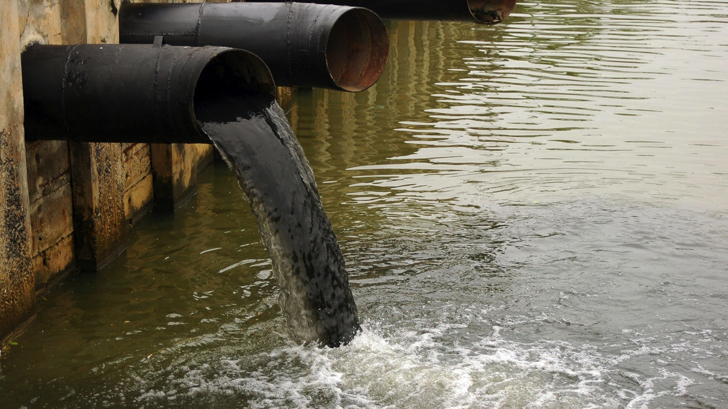
more wastewater
Than ever
The quantity of wastewater produced and its overall pollution load are increasing worldwide
Notes:
More wastewater than ever - 1

Slide 9
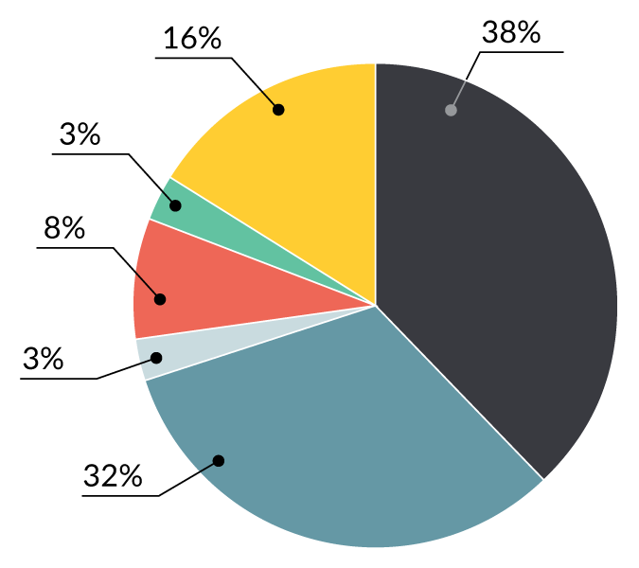
Agricultural water consumption
more wastewater
Than ever
Industrial wastewater
Industrial water consumption
Municipal wastewater
As the overall demand for water grows, the quantity of wastewater produced and its overall pollution load are increasing worldwide
Municipal water consumption
Agricultural drainage
Source: FAO, based on data from AQUASTAT (n.d.a.), Mateo-Sagasta et al. (2015), and Shiklomanov (1999)
Notes:
More wastewater than ever - 5

Slide 10
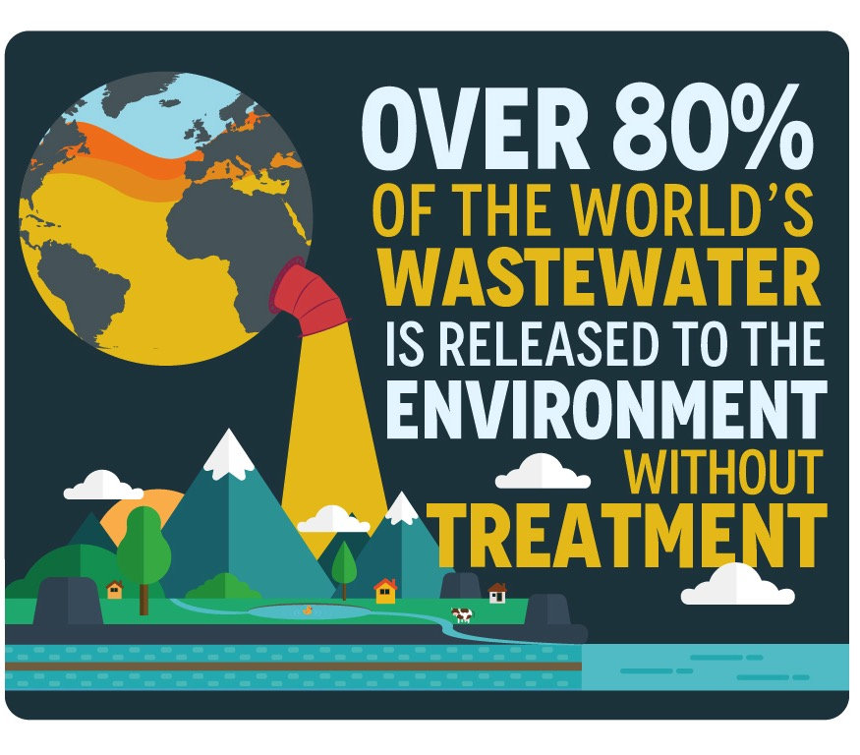
More wastewater than ever
Notes:
More wastewater than ever - 6

Slide 11
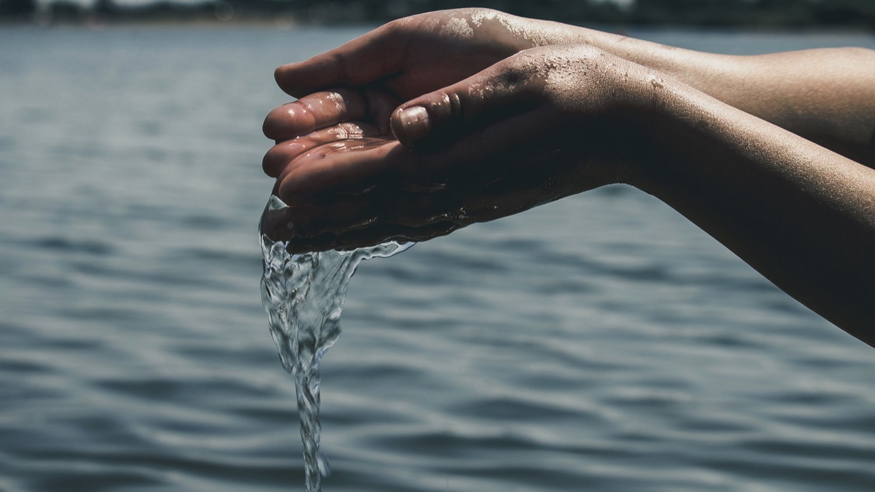
HUMAN HEALTH, SANITATION and the SUSTAINABLE DEVELOPMENT AGENDA
2
Part
Notes:
Part 2 - title

Slide 12
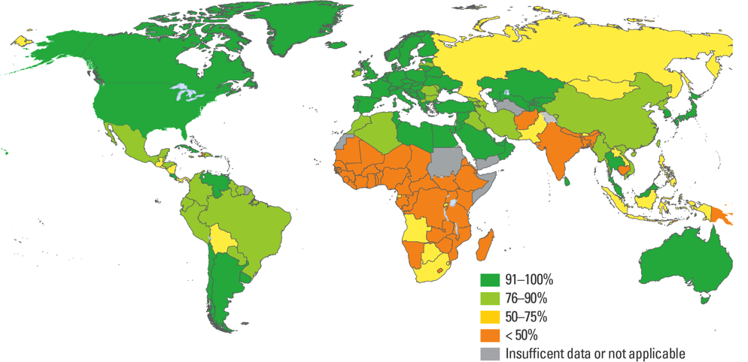
Access to improved sanitation
Human health and improved sanitation
2.4 billion do not have access to improved sanitation
Nearly 1 billion people worldwide still practice open defecation
Source: UNICEF and WHO 2015
Notes:
Human health and improved sanitation

Slide 13
The 2030 agenda
For sustainable
development
SDG Target 6.3: By 2030, improve water quality by reducing pollution, eliminating dumping and minimizing release of hazardous chemicals and materials, halving the proportion of untreated wastewater and substantially increasing recycling and safe reuse globally
Notes:
The 2030 agenda - 1

Slide 14
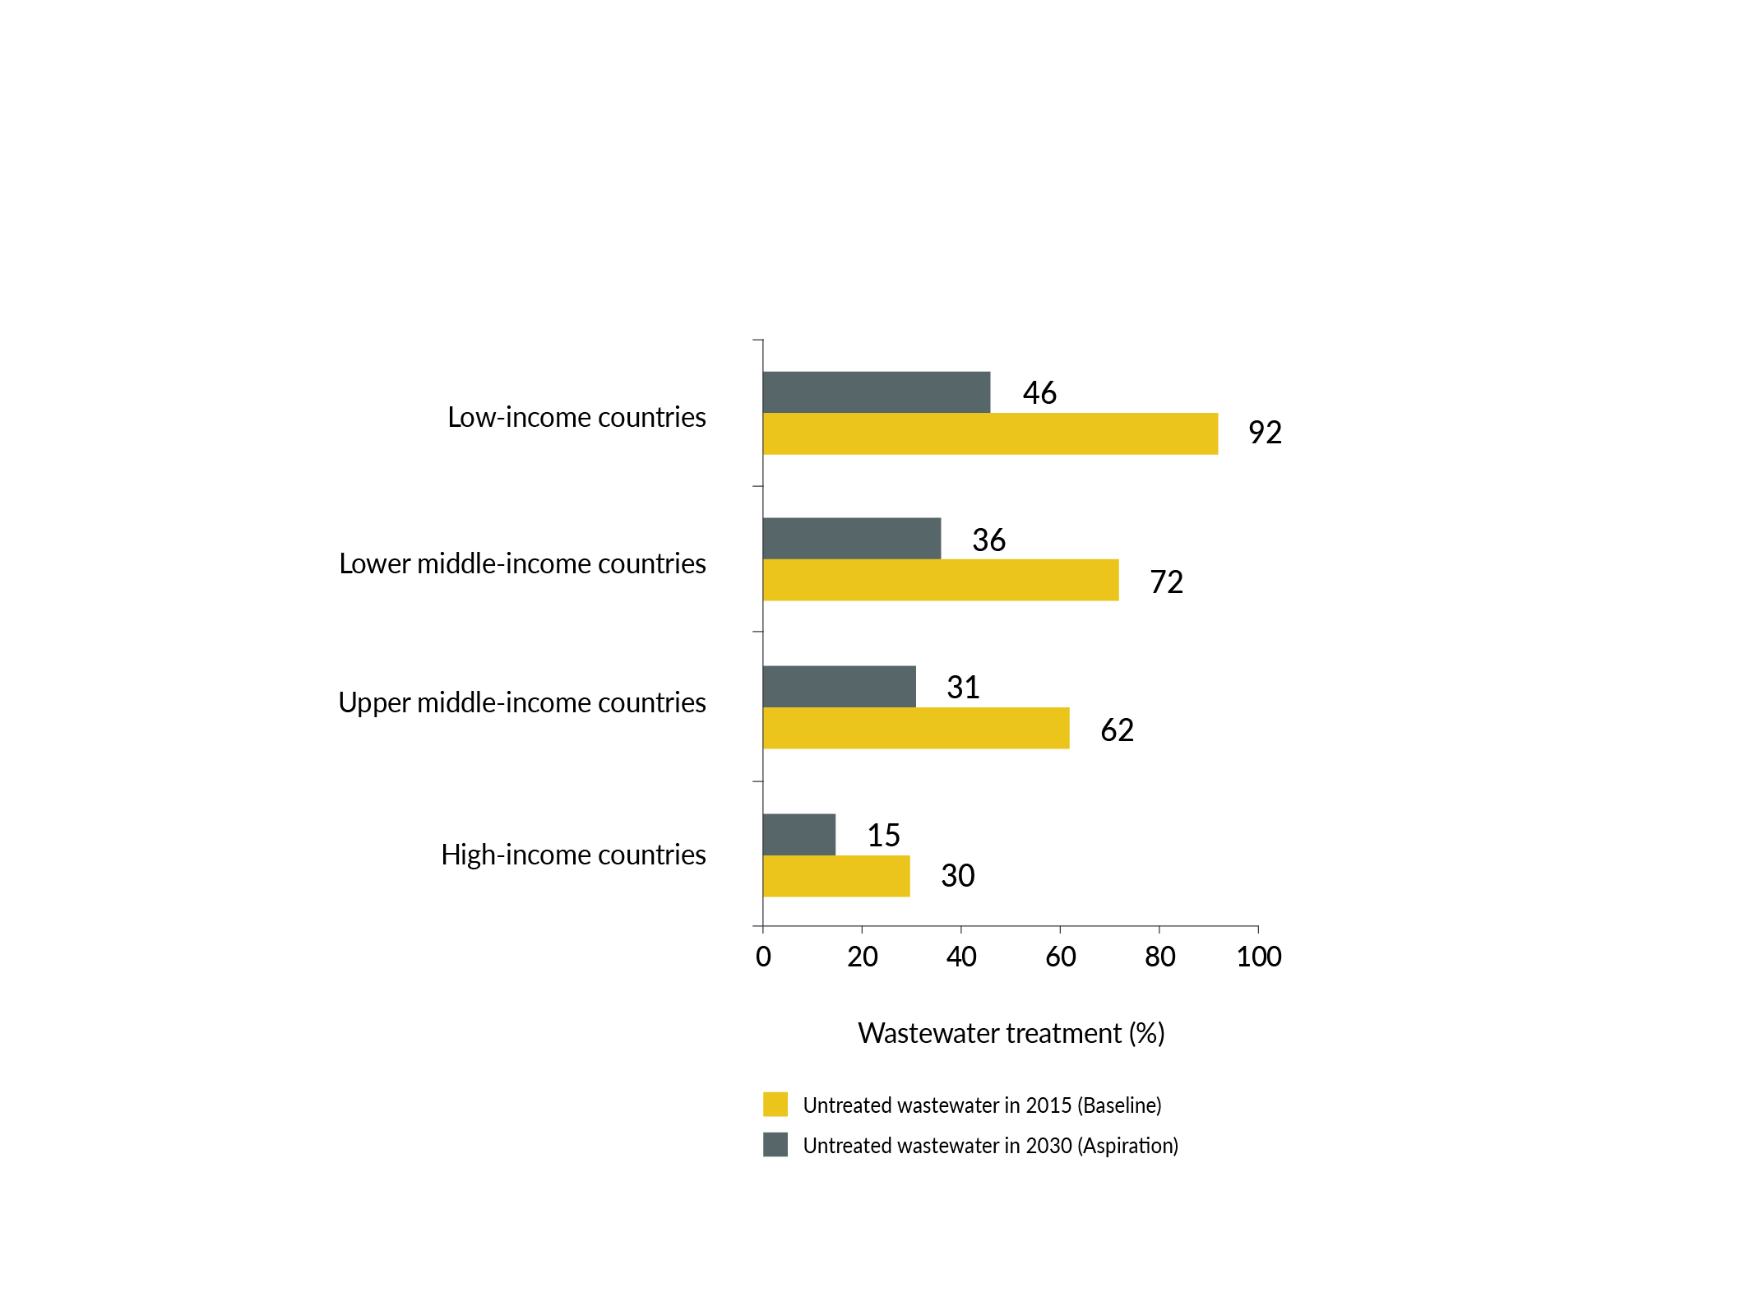
The 2030 agenda
For sustainable
development
SDG Target 6.3: By 2030, improve water quality by reducing pollution, eliminating dumping and minimizing release of hazardous chemicals and materials, halving the proportion of untreated wastewater and substantially increasing recycling and safe reuse globally
Source: Based on data from Sato et al. (2013)
Notes:
The 2030 agenda - 3

Slide 15
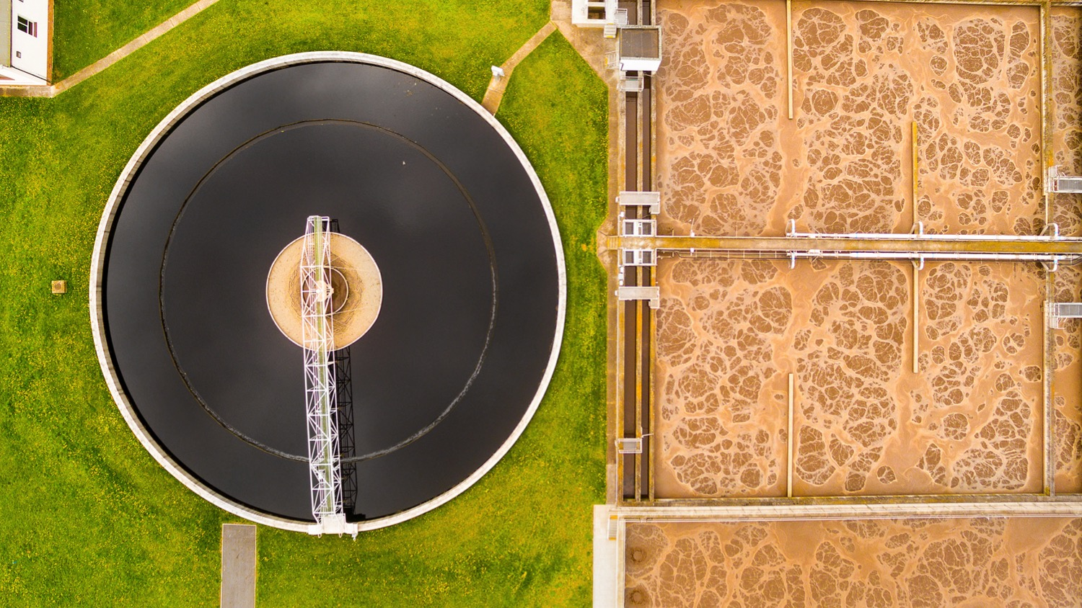
MEETING the CHALLENGE of
IMPROVING WASTEWATER MANAGEMENT
3
Part
Notes:
Part 3 - title

Slide 16
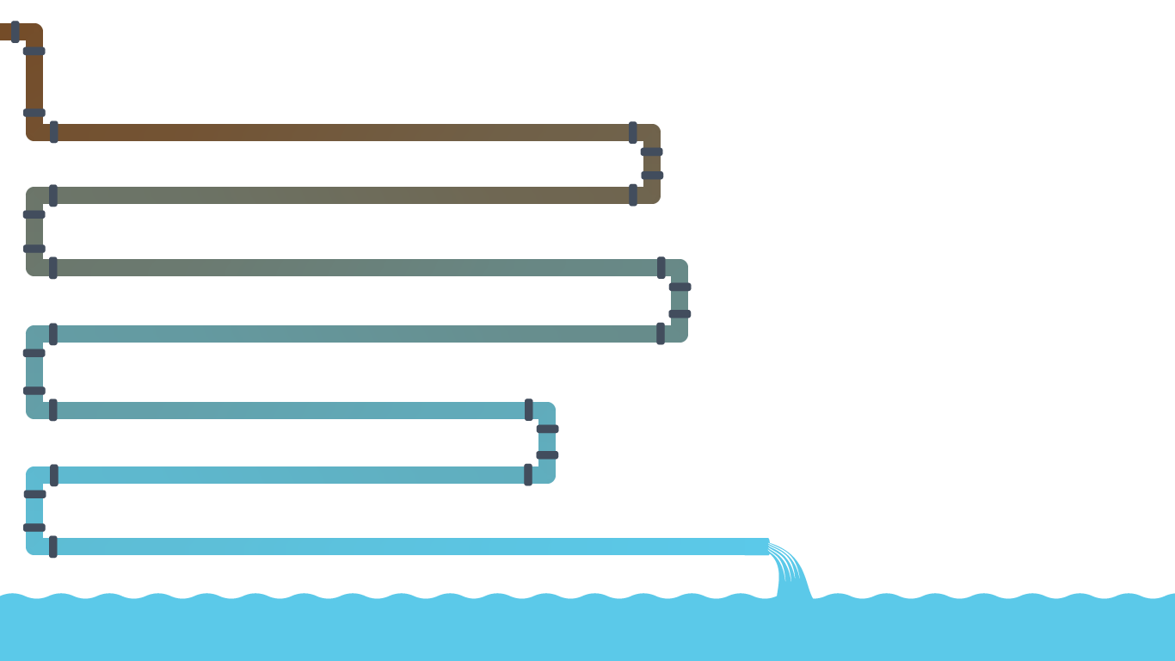
REDUCING
v
REMOVING
v
WASTEWATER:
Not a
BURDEN
REUSING
v
but a
VALUABLE
RESOURCE
RECOVERING
v
Notes:
4 R’s

Slide 17
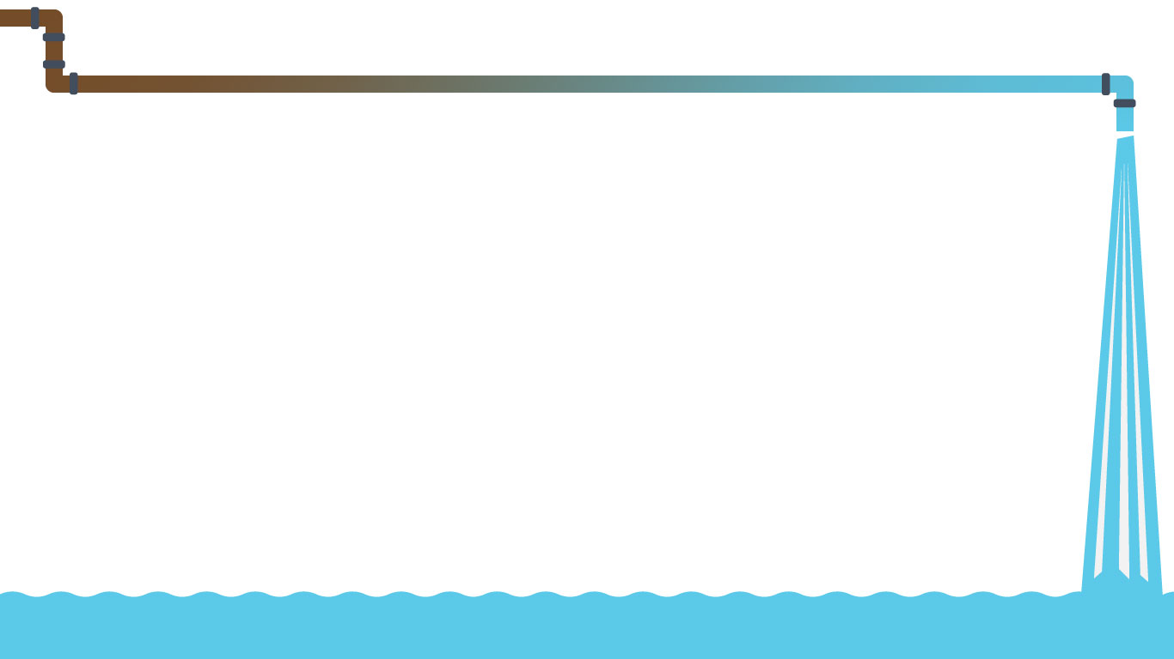
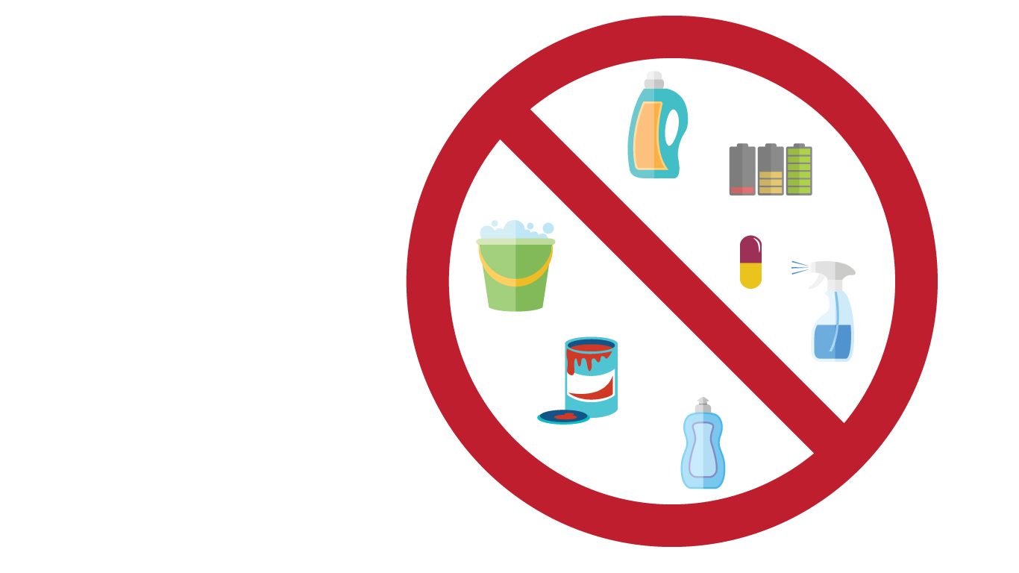
REDUCING or PREVENTING
POLLUTION at the SOURCE
Pollution prevention and the minimization of wastewater flows should be given priority over traditional ‘after-use’ treatment whenever possible
Notes:
Reducing

Slide 18
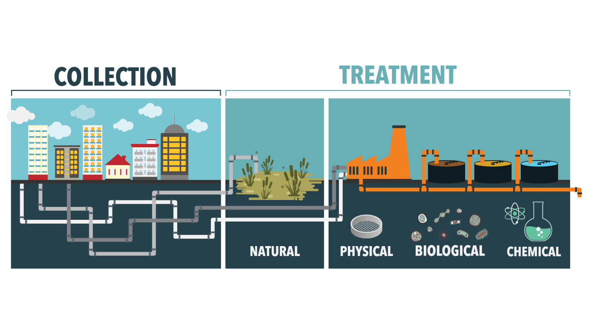
REMOVING CONTAMINANTS from WASTEWATER: COLLECTION and TREATMENT
In Brazil, the cost of simplified sewerage (a type of low-cost sewerage) per person has been shown to be twice lower than the cost of conventional sewerage (i.e. US$170 vs US$390)
Notes:
Removing – pt1

Slide 19
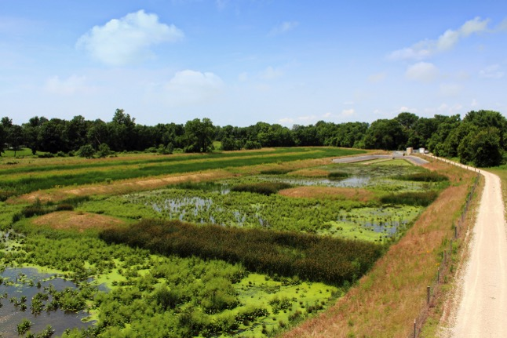
REMOVING CONTAMINANTS from WASTEWATER: COLLECTION and TREATMENT
Healthy ecosystems can also complement engineered solutions to wastewater treatment in a cost-effective manner
Notes:
Removing – pt2

Slide 20
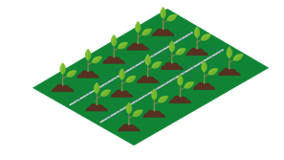
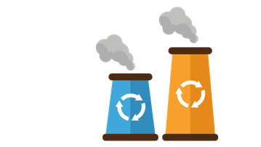

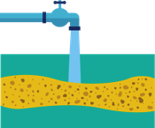

REUSING WATER
IRRIGATION
INDUSTRIAL PROCESSES
POTABLE WATER
AQUIFER RECHARGE
HEATING/COOLING
Treated wastewater is a safe and reliable source of water that can be used to offset water scarcity
Notes:
Reusing
*aquifer recharge (between irrigation and industrial processes)

Slide 21

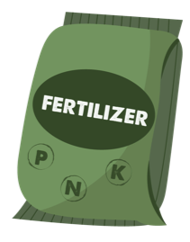

RECOVERING
USEFUL BY-PRODUCTS
The recovery of nutrients and energy can add significant revenue streams to help cover the investment and operational costs of wastewater treatment and sanitation
Wastewater’s vast potential as a source of recoverable resources remains largely underexploited
Notes:
Recovering

Slide 22

CREATING AN ENABLING ENVIRONMENT FOR CHANGE
4
Part
Notes:
Part 4

Slide 23
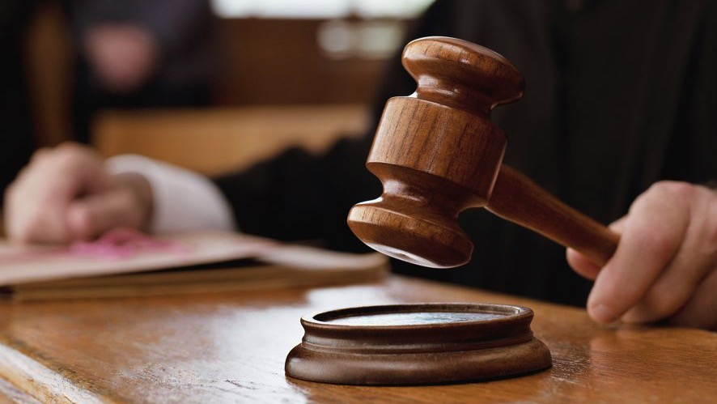
1. SUITABLE LEGAL and REGULATORY FRAMEWORK
At least 11 out of 22 Arab States have adopted legislation permitting the use of treated wastewater
Notes:
1. Suitable legal and regulatory framework

Slide 24
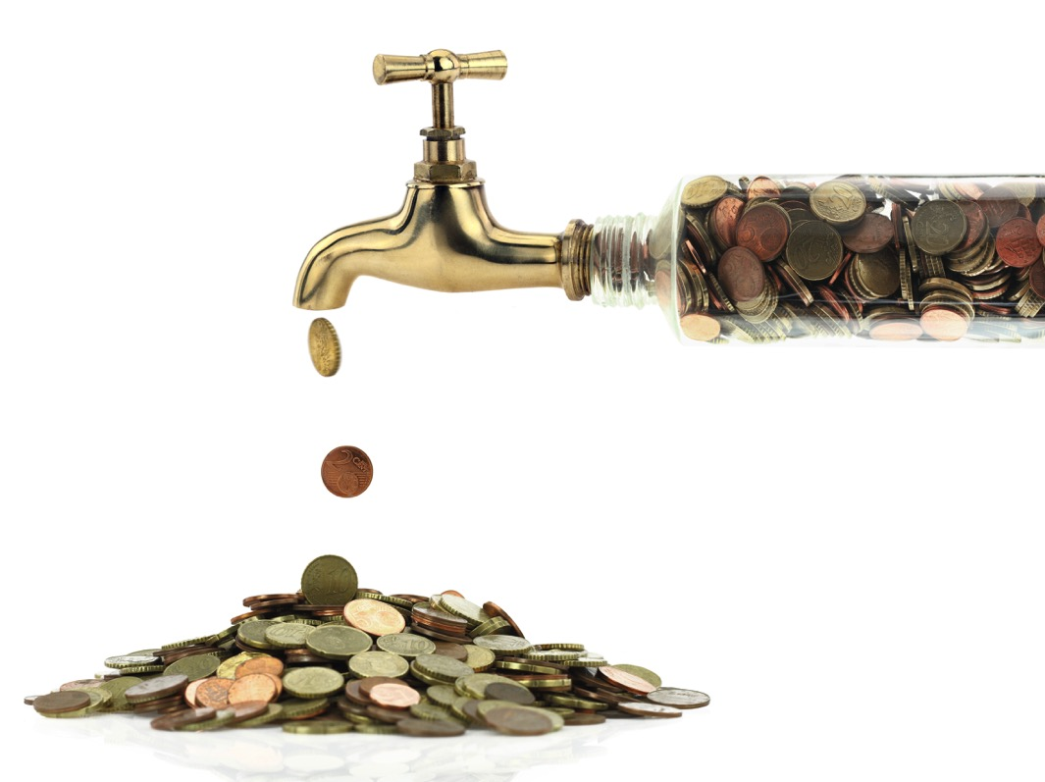
2. COST RECOVERY and APPROPRIATE FINANCING MECHANISMS
The costs of improved wastewater management are usually outweighed by benefits in terms of human health, socioeconomic development and environmental sustainability
Notes:
2. Cost recovery and appropriate financing mechanism

Slide 25
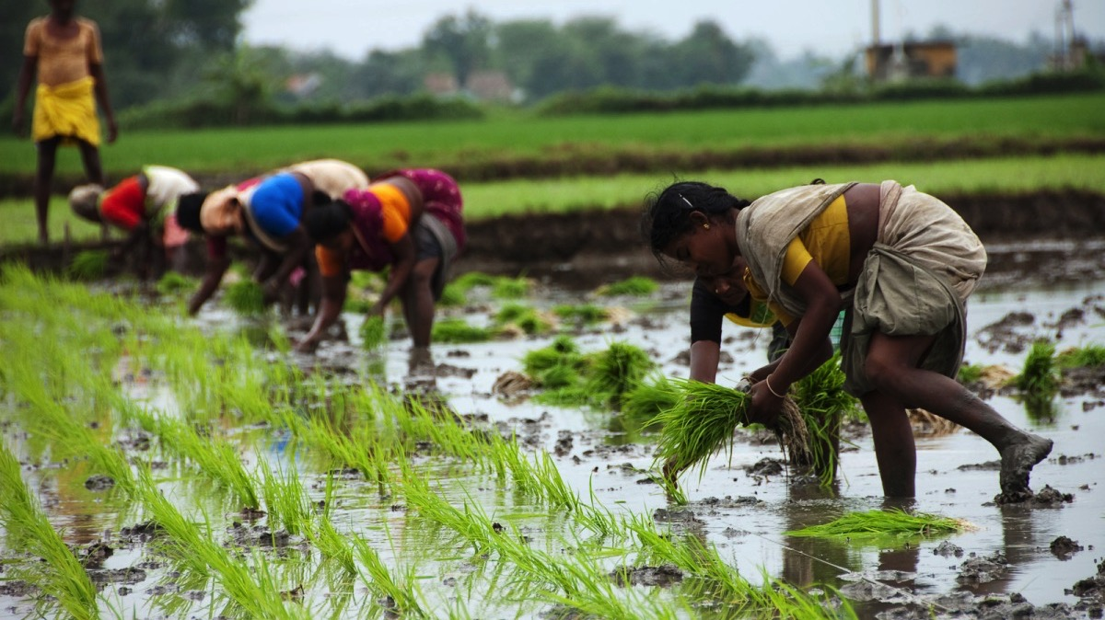
3.
MINIMIZING RISKS to
PEOPLE and the ENVIRONMENT
Exposure of vulnerable groups, especially women and children, to partially treated or untreated wastewater requires specific attention
Notes:
3. Minimizing risks to people and the environment

Slide 26
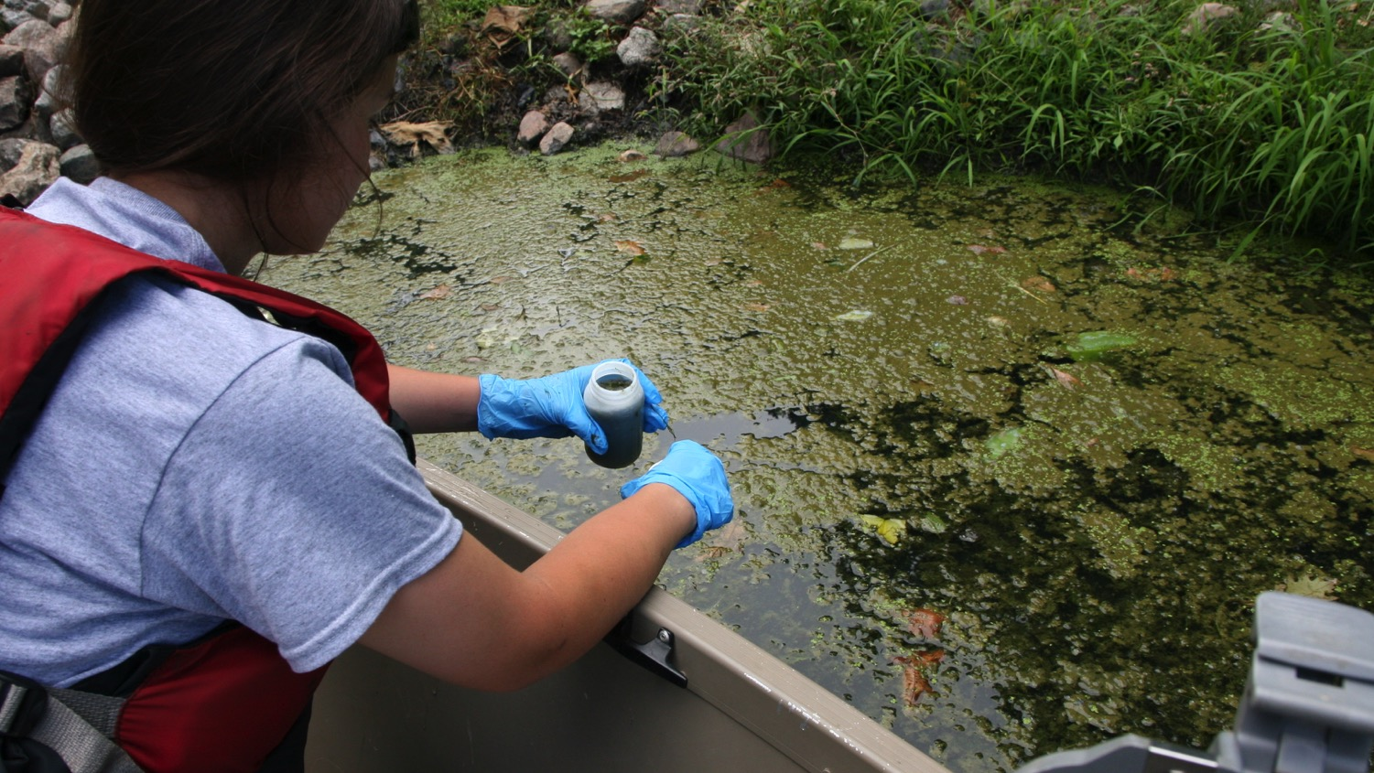
4. BUILDING CAPACITY and
KNOWLEDGE
Capacity building, research and development aimed at improving wastewater management generate employment opportunities and promote green growth
Notes:
4. Building capacity and knowledge

Slide 27
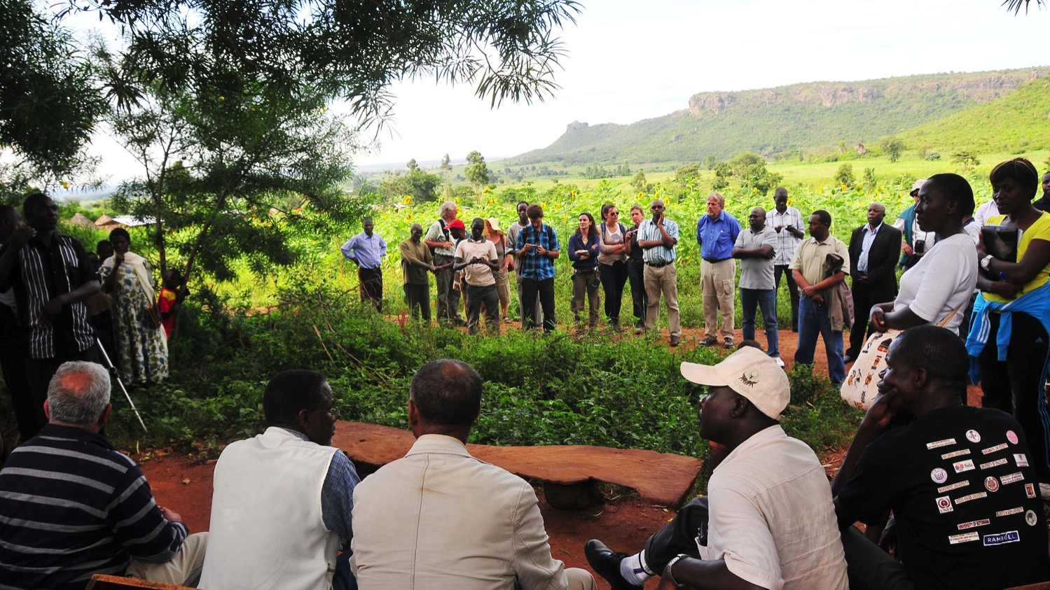
5.
RAISING PUBLIC ACCEPTANCE and SOCIAL AWERENESS
Water reuse schemes can fail if planners do not account for the dynamics of social acceptance
Notes:
5. Rising public acceptance and social awereness – pt1

Slide 28
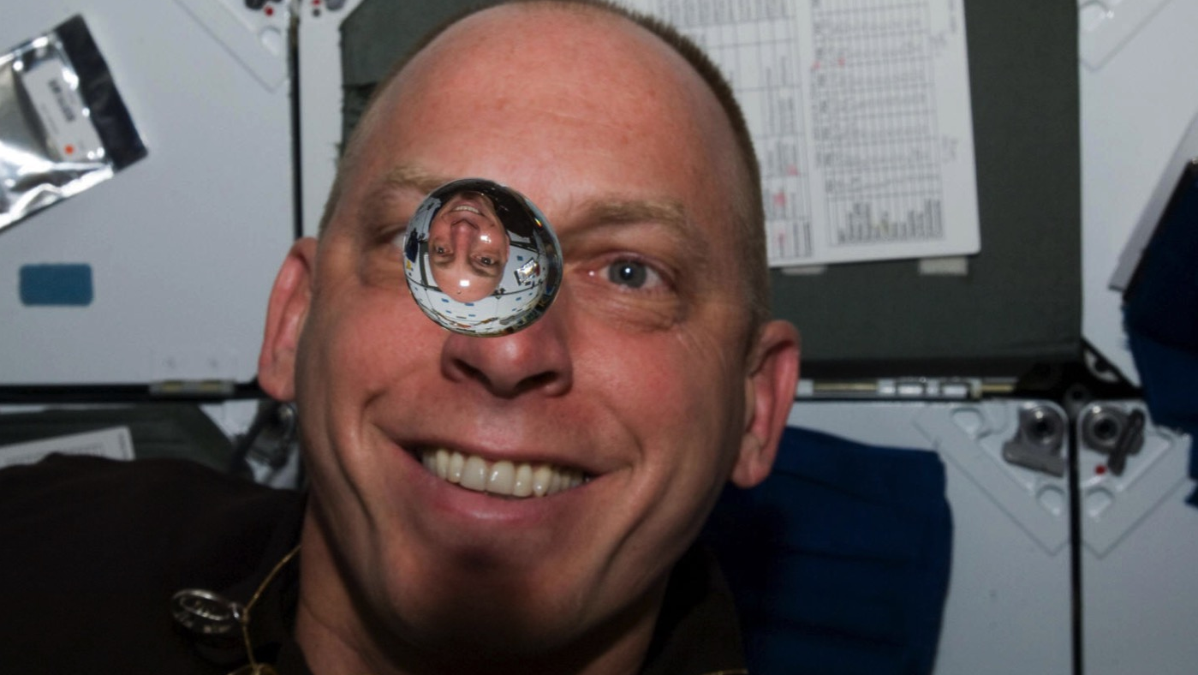
5.
RAISING PUBLIC ACCEPTANCE and SOCIAL AWERENESS
Extensive information campaigns and participation by the public are required to build trust and overcome the so-called ‘yuck’ factor
Notes:
5. Rising public acceptance and social awereness – pt2

Slide 29
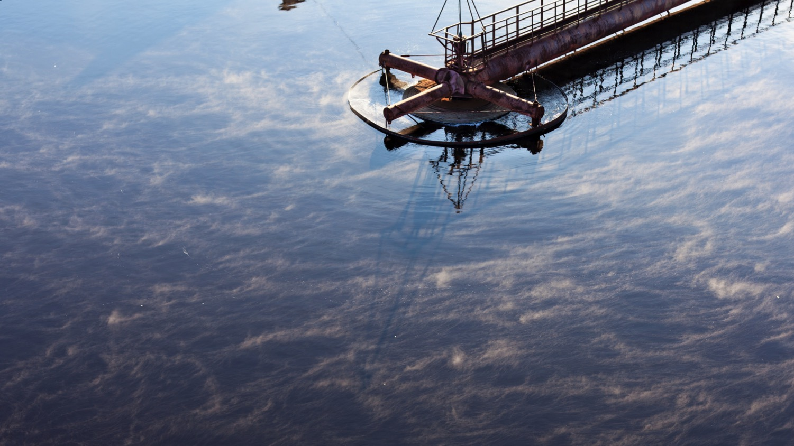
Take home messages
from the wwdr 2017
Wastewater increasing worldwide
Vast majority released without treatment
Affordable (‘low-cost’) treatment options are available
Reliable and sustainable source of water
Sustainable source of energy, nutrients and other recoverable by-products
In a circular economy, wastewater use and by-product recovery can generate new business opportunities while helping finance sanitation services
The costs of improved wastewater management are outweighed by benefits in terms of human health, socioeconomic development and environmental sustainability
Essential for achieving the 2030 Agenda for Sustainable Development
Notes:
Take home messages

Slide 30
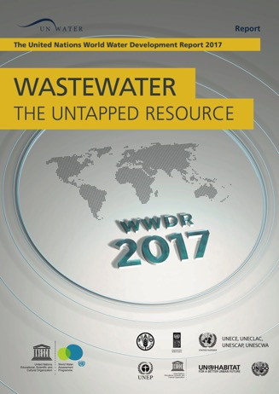
“In a world where demands for freshwater are ever growing, and where limited water resources are increasingly stressed by over-abstraction, pollution and climate change, neglecting the opportunities arising from improved wastewater management is nothing less than unthinkable in the context of a circular economy”
Thank you
You can write your name here.
Here you get a line.
Here you get another line.
wwap@unesco.org
@UNWWAPUNESCO
Download the Report at:
www.unesco.org/water/wwap/wwdr

