Slide 1

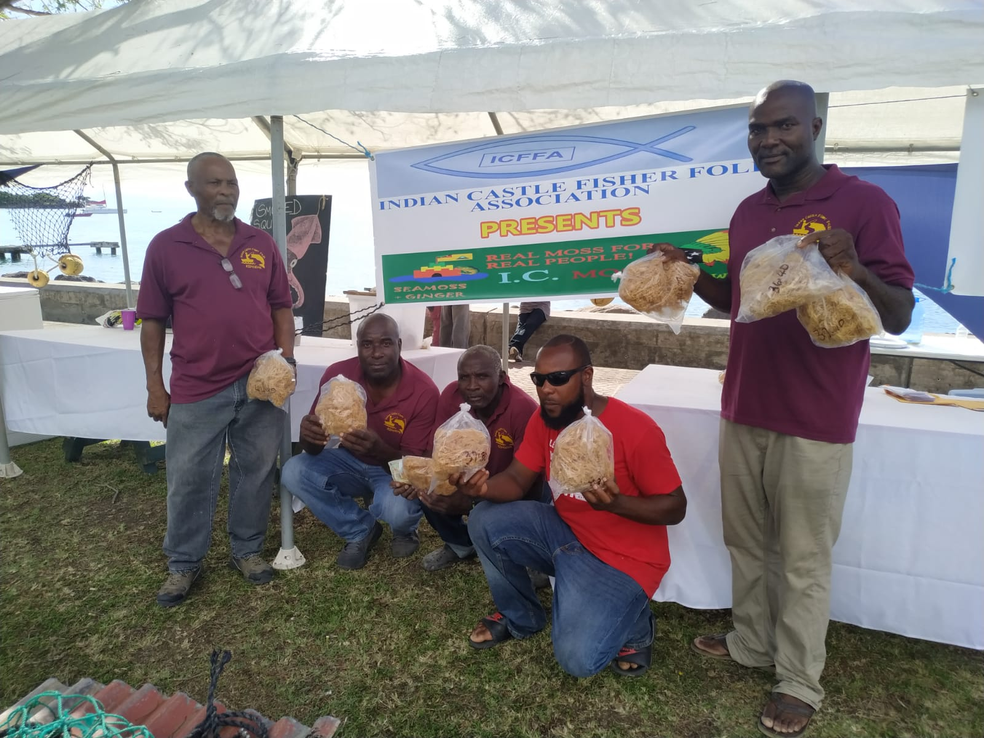
Enhancing and promoting the seamoss industry as a sustainable alternate livelihood of fisherfolk in the Gingerland Community, Nevis
Report of the small grant project
contributing to
Catalyzing Implementation of the Strategic Action Programme (SAP) for the Sustainable Management of shared Living Marine Resources in the Caribbean and North Brazil Shelf Large Marine Ecosystems (CLME+ Project)
Photo credit: ICFFA
Photo credit: ICFFA

Slide 2

Contents
Background to the small grant facility
Overview of the Indian Castle Fisherfolk Association
Issues addressed by the small grant project
Project goal and project objectives
Project activities and key results
Lessons learned and challenges

Slide 3
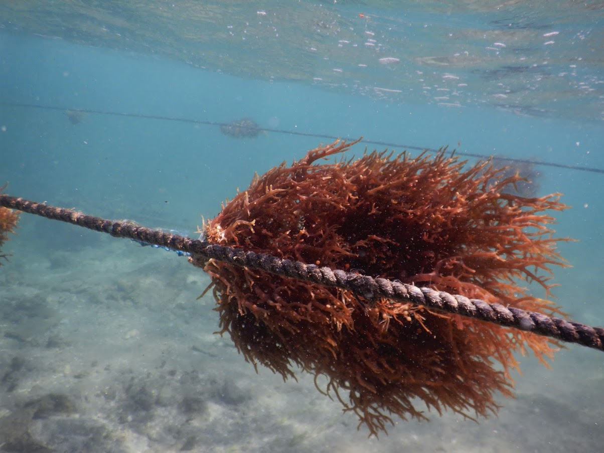
Background to the small grant facility
The Caribbean Natural Resources Institute (CANARI) is supporting civil society’s participation in implementing the politically endorsed 10-year Strategic Action Programme for the Sustainable Management of the Shared Living Marine Resources of the Caribbean and North Brazil Shelf Large Marine Ecosystems (CLME+ SAP).
This work was supported under the 2015-2020 project Catalyzing Implementation of the Strategic Action Programme (SAP) for the Sustainable Management of shared Living Marine Resources in the Caribbean and North Brazil Shelf Large Marine Ecosystems (CLME+ Project) which seeks to initiate implementation of the CLME+ SAP.
As a project executing partner, CANARI’s sub-project included administering a US$70,000 small grant facility to support two initiatives aimed at building the capacity of stakeholders in St. Kitts and Nevis in seamoss farming, as a demonstration of alternative livelihoods initiatives within the concept of ecosystem-based management.
The Indian Castle Fisherfolk Association (ICFFA) received a small grant of US$17,650 from this small grant facility for their project Enhancing and promoting the sea moss industry as a sustainable alternate livelihood for fisherfolk in the Gingerland Community, Nevis.
Photo credit: United Nations Food and Agriculture Organization (FAO)//Stankus

Slide 4
Overview of the Indian Castle Fisherfolk Association
The ICFFA was formed in 2013 after several fisherfolk met initially to organise a fishing tournament. The tournament was a success and the group expanded and has resulted in what it is today. The ICFFA is currently governed by 3 members who serve as the Executive of the group. The current membership is 26 with 3 being women.
The mission of the ICFFA is to encourage camaraderie and sportsmanship amongst its members; to educate its members in all areas of good fishing practice so as to reduce adverse impacts of unsustainable fishing practice; to enhance the livelihood of fishers and to promote social and community development.
The ICFFA was cultivating and processing seamoss, producing seamoss drink products and marketing the products at its retail outlet. The ICFFA was operating a small seamoss farm on the beach at Indian Castle (Little Bay) in Nevis. The plot was in its very infant stage. Although production was done on a small scale, it was based on availability of the dried seamoss which was purchased from local fishers and from Grenada.
Photo credit: ICFFA

Slide 5
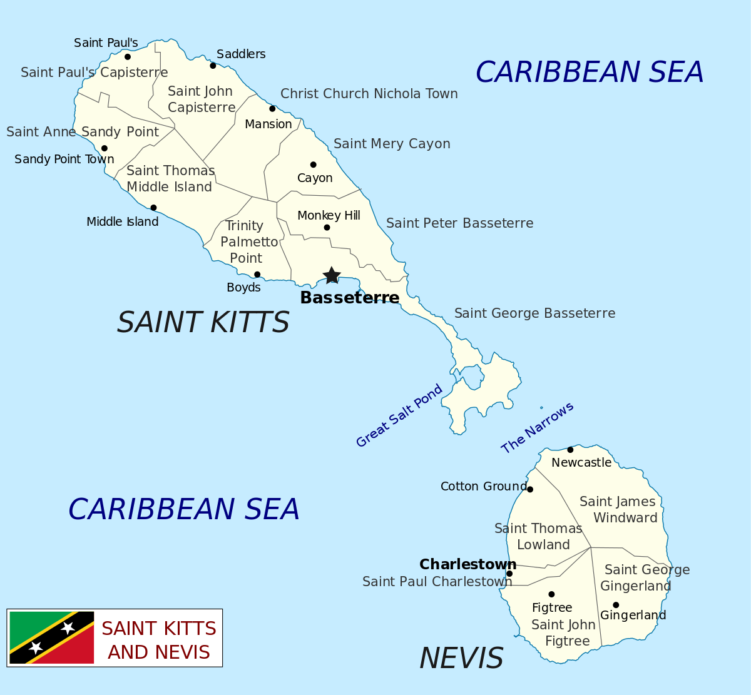
Issues addressed by the small grant project
While the ICFFA’s production of seamoss drink products was done on a small scale, it was based on the availability of dried seamoss which was purchased from local fishers and from Grenada. In addition, the equipment used for production and labeling was the property of the Agro-processing Unit.
In order to meet the demand for seamoss drinks locally, the ICFFA needed to expand its level of operations, reduce its reliance on the Agro-processing Unit and improve the quality and consistency of the product as a number of local businesses expressed an interest in becoming outlets for drink.
Many persons were becoming health conscious and were seeking products that offer much healthier benefits. Therefore, ICFFA also had to embark on a campaign that creates an awareness of the nutritional properties and potential health benefits of seamoss and the work of the Association. There was also the possibility of marketing the product regionally.
Indian Castle
Map: Location of ICFFA’s operation in Nevis

Slide 6





Project goal
Project objectives
The goal of the Enhancing and promoting the seamoss industry as a sustainable alternate livelihood of fisherfolk in the Gingerland community, Nevis project was to develop seamoss cultivation and production as an alternate income for the ICFFA to assist fishers in maintaining a sustainable livelihood as they try to mitigate the financial impacts of the reduced catch presently experienced due to climate change and other factors.
To expand the ICFFA’s current seamoss farm by increasing the number of plots
To improve the quality and consistency of seamoss products (dried seamoss and drink) and ensure that products comply with the Bureau of Standards’ and Health Department’s requirements
To build the capacity of ICFFA members in small and micro enterprise development and management and value-added processing
To upgrade the ICFFA’s current processing and storage facilities
To improve marketing for ICFFA’s seamoss products

Slide 7
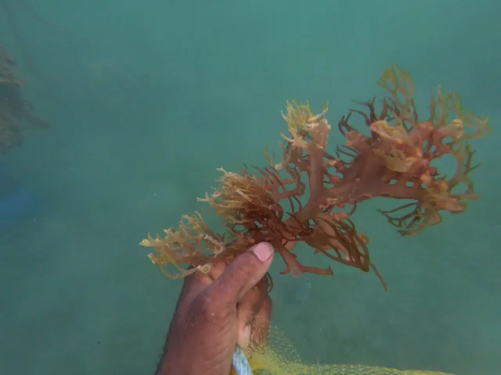

Result 1: Three new seamoss plots established
The ICFFA collaborated with the Department of Marine Resources to establish 3 new seamoss plots at their seamoss farm in Indian Castle (Little Bay).
Activities implemented:
Procured materials to develop 3 new Seamoss plots
Worked with the Department of Marine Resources to set up 3 new plots. (The Department of Marine Resources supplied the initial seamoss seedling and assisted in setting up of the first plot)
Key results:
3 new seamoss plots
Capacity of ICFFA built in seamoss cultivation
Video courtesy: ICFFA
Video: ICFFA members harvesting Seamoss from their seamoss farm
Click here

Slide 8
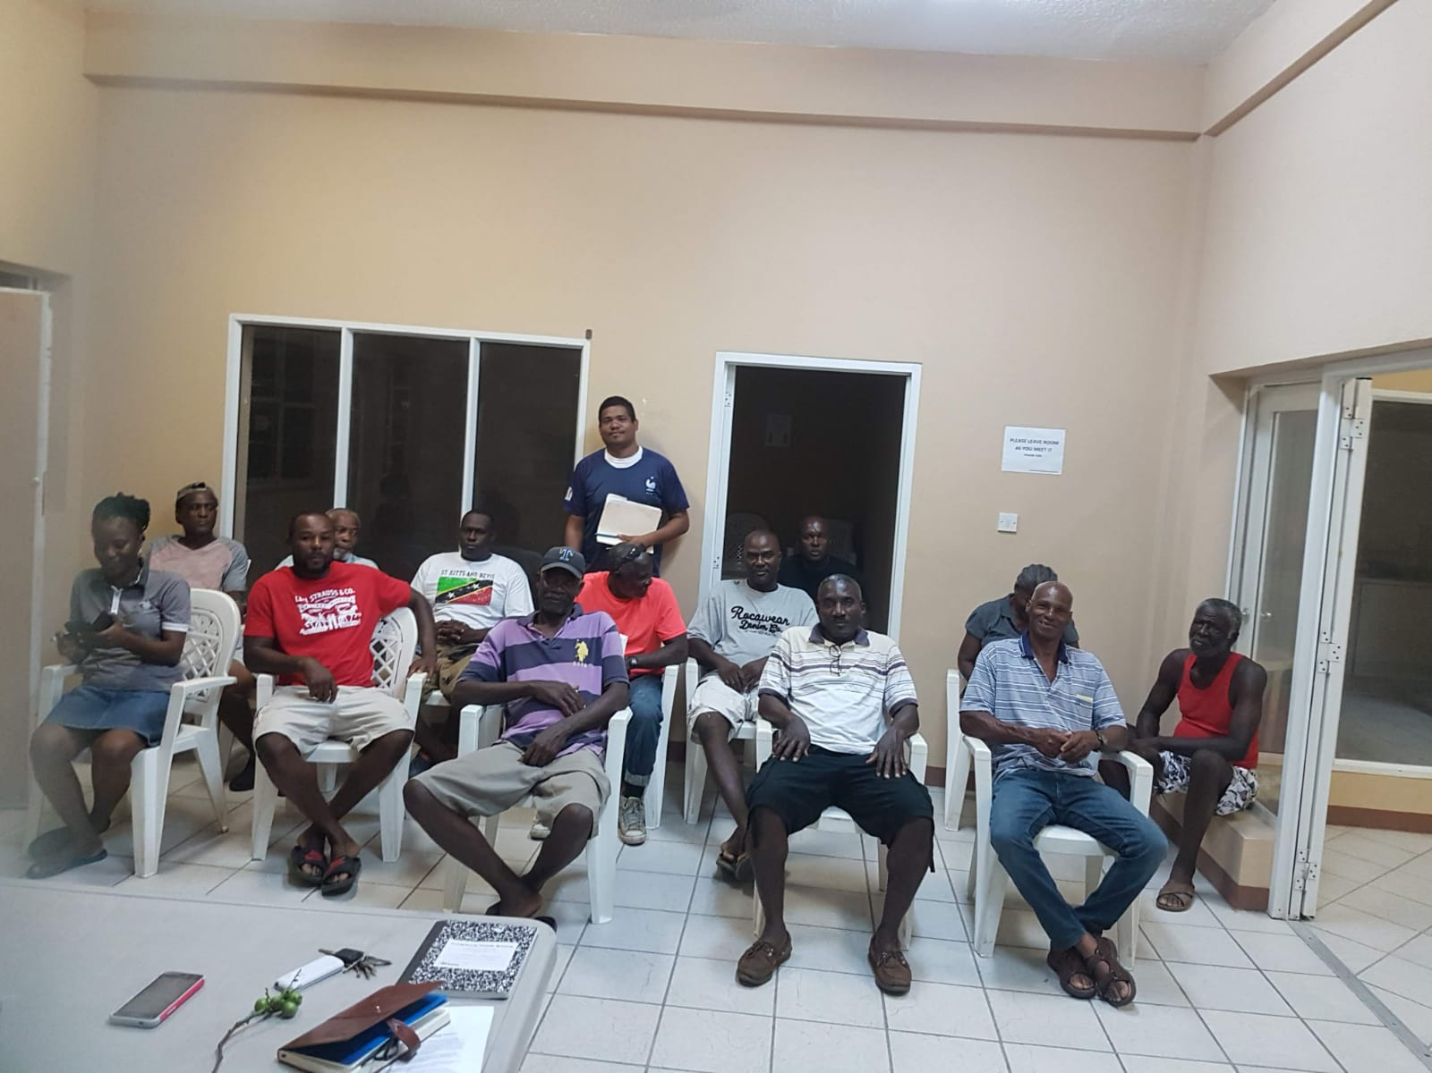
Result 2: Capacity of ICFFA members built in in small and micro enterprise development and management
ICFFA members participated in a one-day workshop focused on marketing and brand positioning for small and micro enterprises.
Activities implemented:
Hired the services of a marketing specialist to train ICFFA members in marketing
Convened one-day training workshop in marketing for small and micro enterprises
Key results:
9 members (7 men, 2 women) built capacity in marketing and brand positioning
Photo credit: ICFFA
Image: Group photo of ICFFA members in marketing workshop

Slide 9
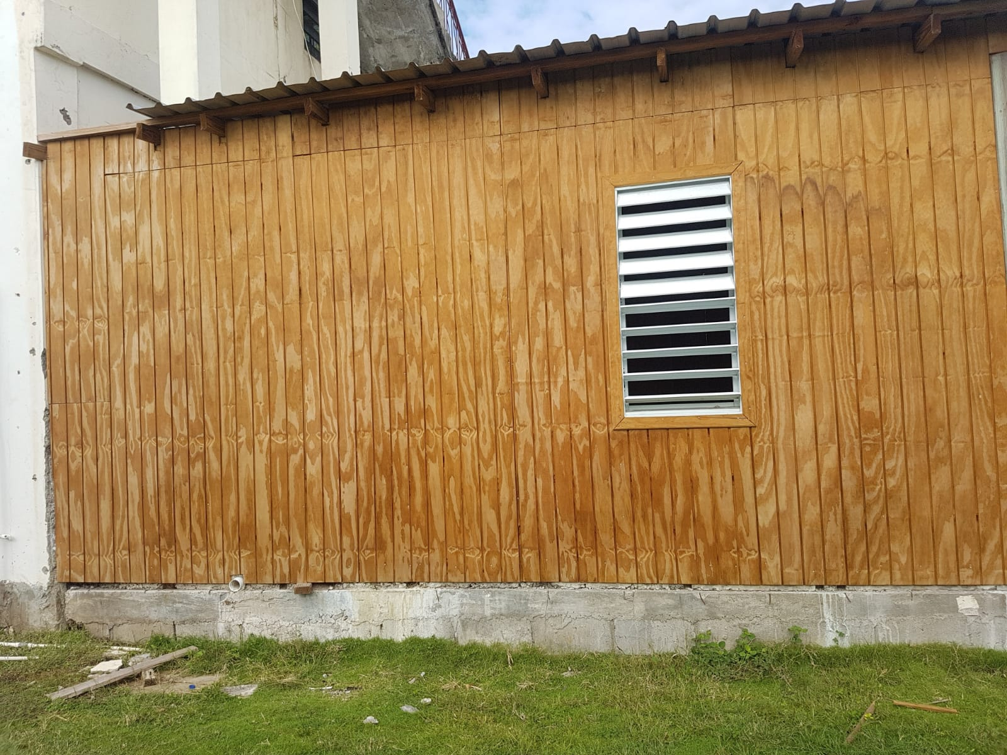
Result 3: Upgrades made to ICFFA’s processing and storage facilities
The ICFFA upgraded their current processing and storage facility for their seamoss enterprise.
Activities implemented:
Procured materials and equipment to upgrade the current facility including refrigerator, stove and generator
Modified present facility to accommodate production and storage
Key results:
Upgraded processing and storage facility
Reduced reliance on facilities at Agro-processing Unit for production of seamoss products
Photo credit: ICFFA
Image: Upgraded storage facility constructed by the ICFFA

Slide 10
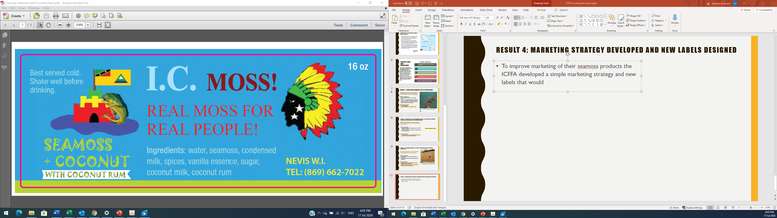
Result 4: Marketing strategy developed and new labels designed
To improve marketing of their seamoss products the ICFFA developed a simple marketing strategy and designed new labels for their range of seamoss drinks.
Activities implemented:
Developed a simple marketing strategy (this was done as one of the activities during the small and micro enterprise training workshop)
Designed new labels for range of seamoss drinks
Image: ICFFA’s new label for their seamoss and coconut drink
Key results:
Simple marketing strategy to guide marketing of the ICFFA’s Seamoss products
New, more attractive labels for ICFFA’s range of seamoss drinks, which includes ingredients listing

Slide 11
Challenges
Lessons learned
Capacity building in the more technical aspects of seamoss cultivation before project start-up could have facilitated faster roll out of some key project activities.
Seeking early buy-in and having better communication about the project and its progress with Association members could have improved the commitment of more members to support with implementing the project.
Some of the key challenges identified by the ICFFA in implementing their small grant project were:
Difficulty in accessing input materials - the initial seedlings to start the seamoss plots were difficult to locate.
Unfavourable sea conditions – two seamoss plots were damaged due to the high wave activity in the area selected for the seamoss plot. The Association eventually had to relocate their plots to another better sheltered area and use larger anchors.
Inadequate support provided on more technical aspects of seamoss cultivation.
Theft of plot materials.
Low commitment among Association members to follow through on assigned tasks.

Slide 12
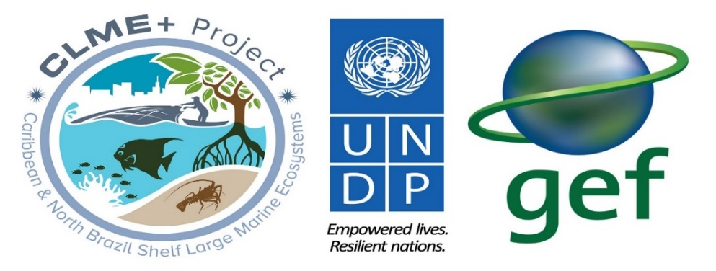

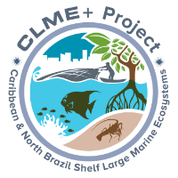

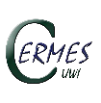







This Information Product was developed under the Engaging Civil Society in CLME+ SAP Implementation project which is being executed by the Caribbean Natural Resources Institute (CANARI) as a component of the CLME+ Project. The five-year (2015 – 2020) CLME+ Project is being implemented by the United Nations Development Programme (UNDP) and co-financed by the Global Environment Facility (GEF).
CLME+ Project co-executing partners:
Disclaimer:
The designations employed and the presentation of information in any format in this Information Product do not imply the expression of any opinion whatsoever on the part of the GEF, UNDP and/or any of the CLME+ Project co-executing partners concerning the legal status of any country, territory, city or area or of its authorities, or concerning the delimitation of its frontiers or boundaries. Unless expressly stated otherwise, the content, facts, findings, interpretations, conclusions, views and opinions expressed in this Information Product are those of CANARI, and publication as a CLME+ Project Information Product does not by itself constitute an endorsement of the GEF, UNDP and/or any of the CLME+ Project co-executing partners of such content, facts, findings, interpretations, conclusions, views or opinions. The GEF, UNDP and/or any of the CLME+ Project co-executing partners do not warrant that the information contained in this Information Product is complete and correct and shall not be liable whatsoever for any damages incurred as a result of its use.
For more information contact CANARI at info@canari.org

