Slide 1
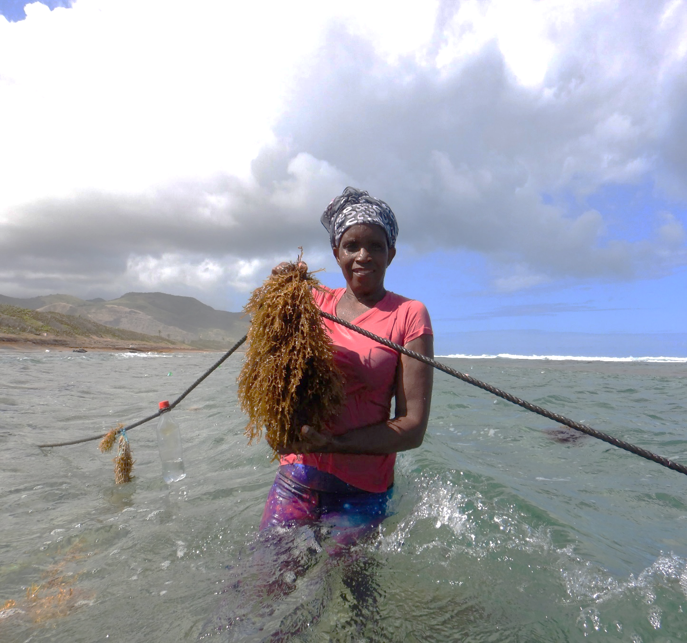
Enhancing and promoting the seamoss industry within St. Kitts and Nevis to promote social empowerment and food and nutrition security
Report of the small grant project
contributing to
Catalyzing Implementation of the Strategic Action Programme (SAP) for the Sustainable Management of shared Living Marine Resources in the Caribbean and North Brazil Shelf Large Marine Ecosystems (CLME+ Project)
Photo credit: United Nations Food and Agriculture Organization (FAO)

Slide 2
Contents
Background to the small grant facility
Overview of the Liamuiga Seamoss Group
Issues addressed by the small grant project
Project goal and project objectives
Project activities and key results
Lessons learned and challenges

Slide 3
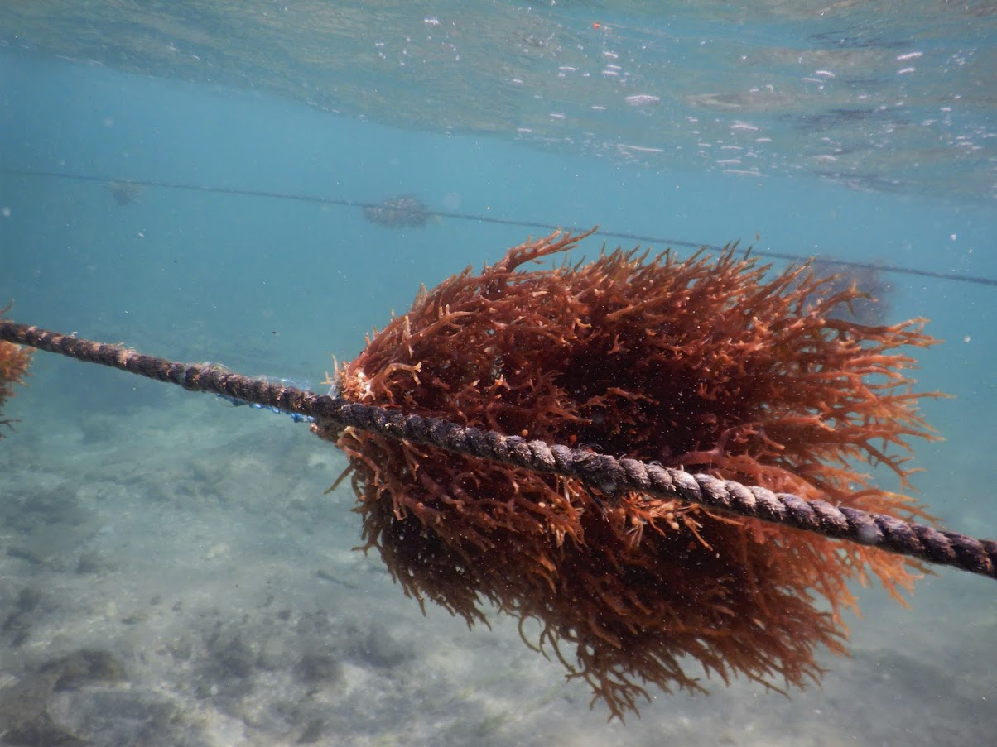
Background to the small grant facility
The Caribbean Natural Resources Institute (CANARI) is supporting civil society’s participation in implementing the politically endorsed 10-year Strategic Action Programme for the Sustainable Management of the Shared Living Marine Resources of the Caribbean and North Brazil Shelf Large Marine Ecosystems (CLME+ SAP).
This work was supported under the 2015-2020 project Catalyzing Implementation of the Strategic Action Programme (SAP) for the Sustainable Management of shared Living Marine Resources in the Caribbean and North Brazil Shelf Large Marine Ecosystems (CLME+ Project) which seeks to initiate implementation of the CLME+ SAP.
As a project executing partner, CANARI’s sub-project included administering a US$70,000 small grant facility to support two initiatives aimed at building the capacity of stakeholders in St. Kitts and Nevis in seamoss farming, as a demonstration of alternative livelihoods initiatives within the concept of ecosystem-based management.
In March 2019, the Liamuiga Seamoss Group received a small grant of US$35, 170 from this small grant facility for their project, “Enhancing and promoting the sea moss industry within St. Kitts and Nevis to promote social empowerment and food and nutrition security”.
Photo credit: United Nations Food and Agriculture Organization (FAO)//Stankus

Slide 4
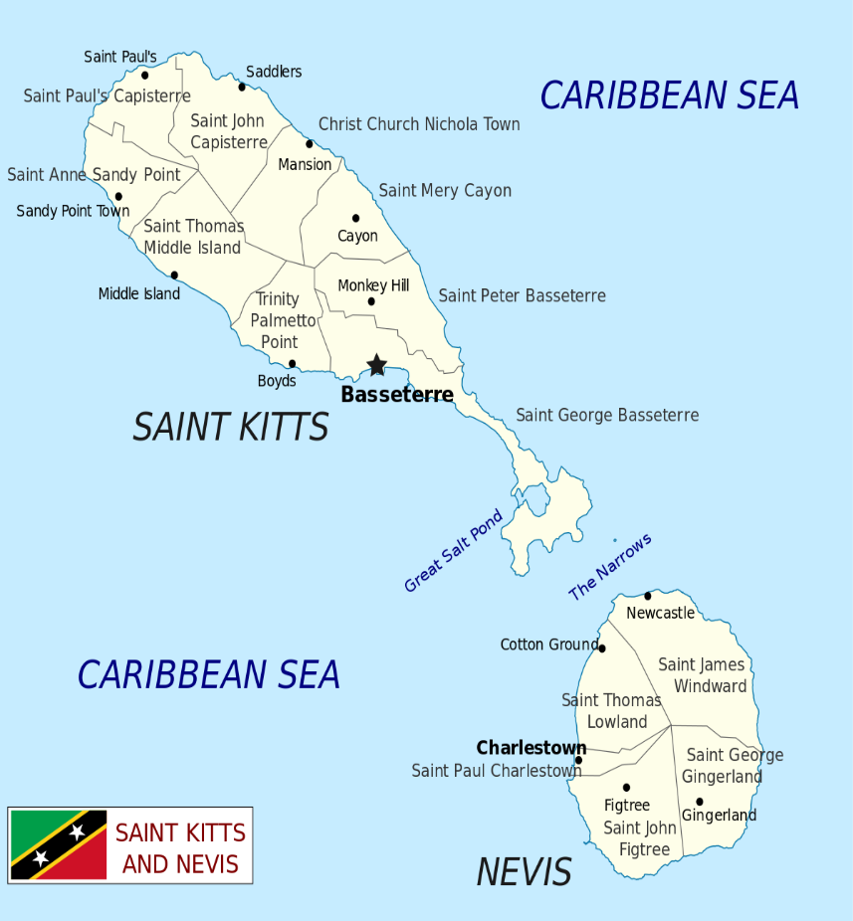
Overview of the Liamuiga Seamoss Group
The mission of the Liamuiga Seamoss Group is to supply high quality seamoss products while promoting the nutritional properties and health benefits of seamoss.
The group was formed in 2017 after a number of agro-processors and fisherfolk who were already involved in the harvesting and/or production of seamoss products from seamoss grown in the wild recognised that the increasing local demand for seamoss products could not be met due to the increasing pressure on wild seamoss stocks. With this in mind, the group was formed to establish a business that would be responsible for the cultivation of seamoss as well as the production and marketing of seamoss products.
Liamuiga Seamoss Group was cultivating, processing seamoss, producing a variety of seamoss drink products and marketing the products locally at fairs and on an order basis.
The Group was operating a small seamoss farm on the beach in Conaree Village in St. Kitts while processing (drying) was done at a member’s private residence. Production of drinks and storage of products was done at the Ministry of Agriculture Agro-processing Unit.
Conaree Village
Photo credit: Liamuiga Seamoss Group
Map: Location of the Liamugia Seamoss Group’s operation in St. Kitts

Slide 5
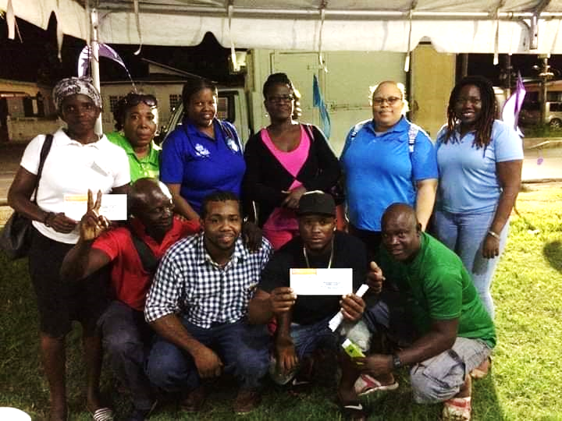
Overview of the Liamuiga Seamoss Group (cont’d)
At the start of the project, the Group was governed by the five members who serve as the executive of the group.
Since the establishment of the group in 2017, it has grown in number and the membership was 23, with 12 being women.
In addition, a number of youth in the Conaree community where the seamoss farm is located have been supporting the work of the Liamuiga Seamoss Group by assisting regularly in the cultivation of seamoss at the site.
Photo credit: Liamuiga Seamoss Group

Slide 6
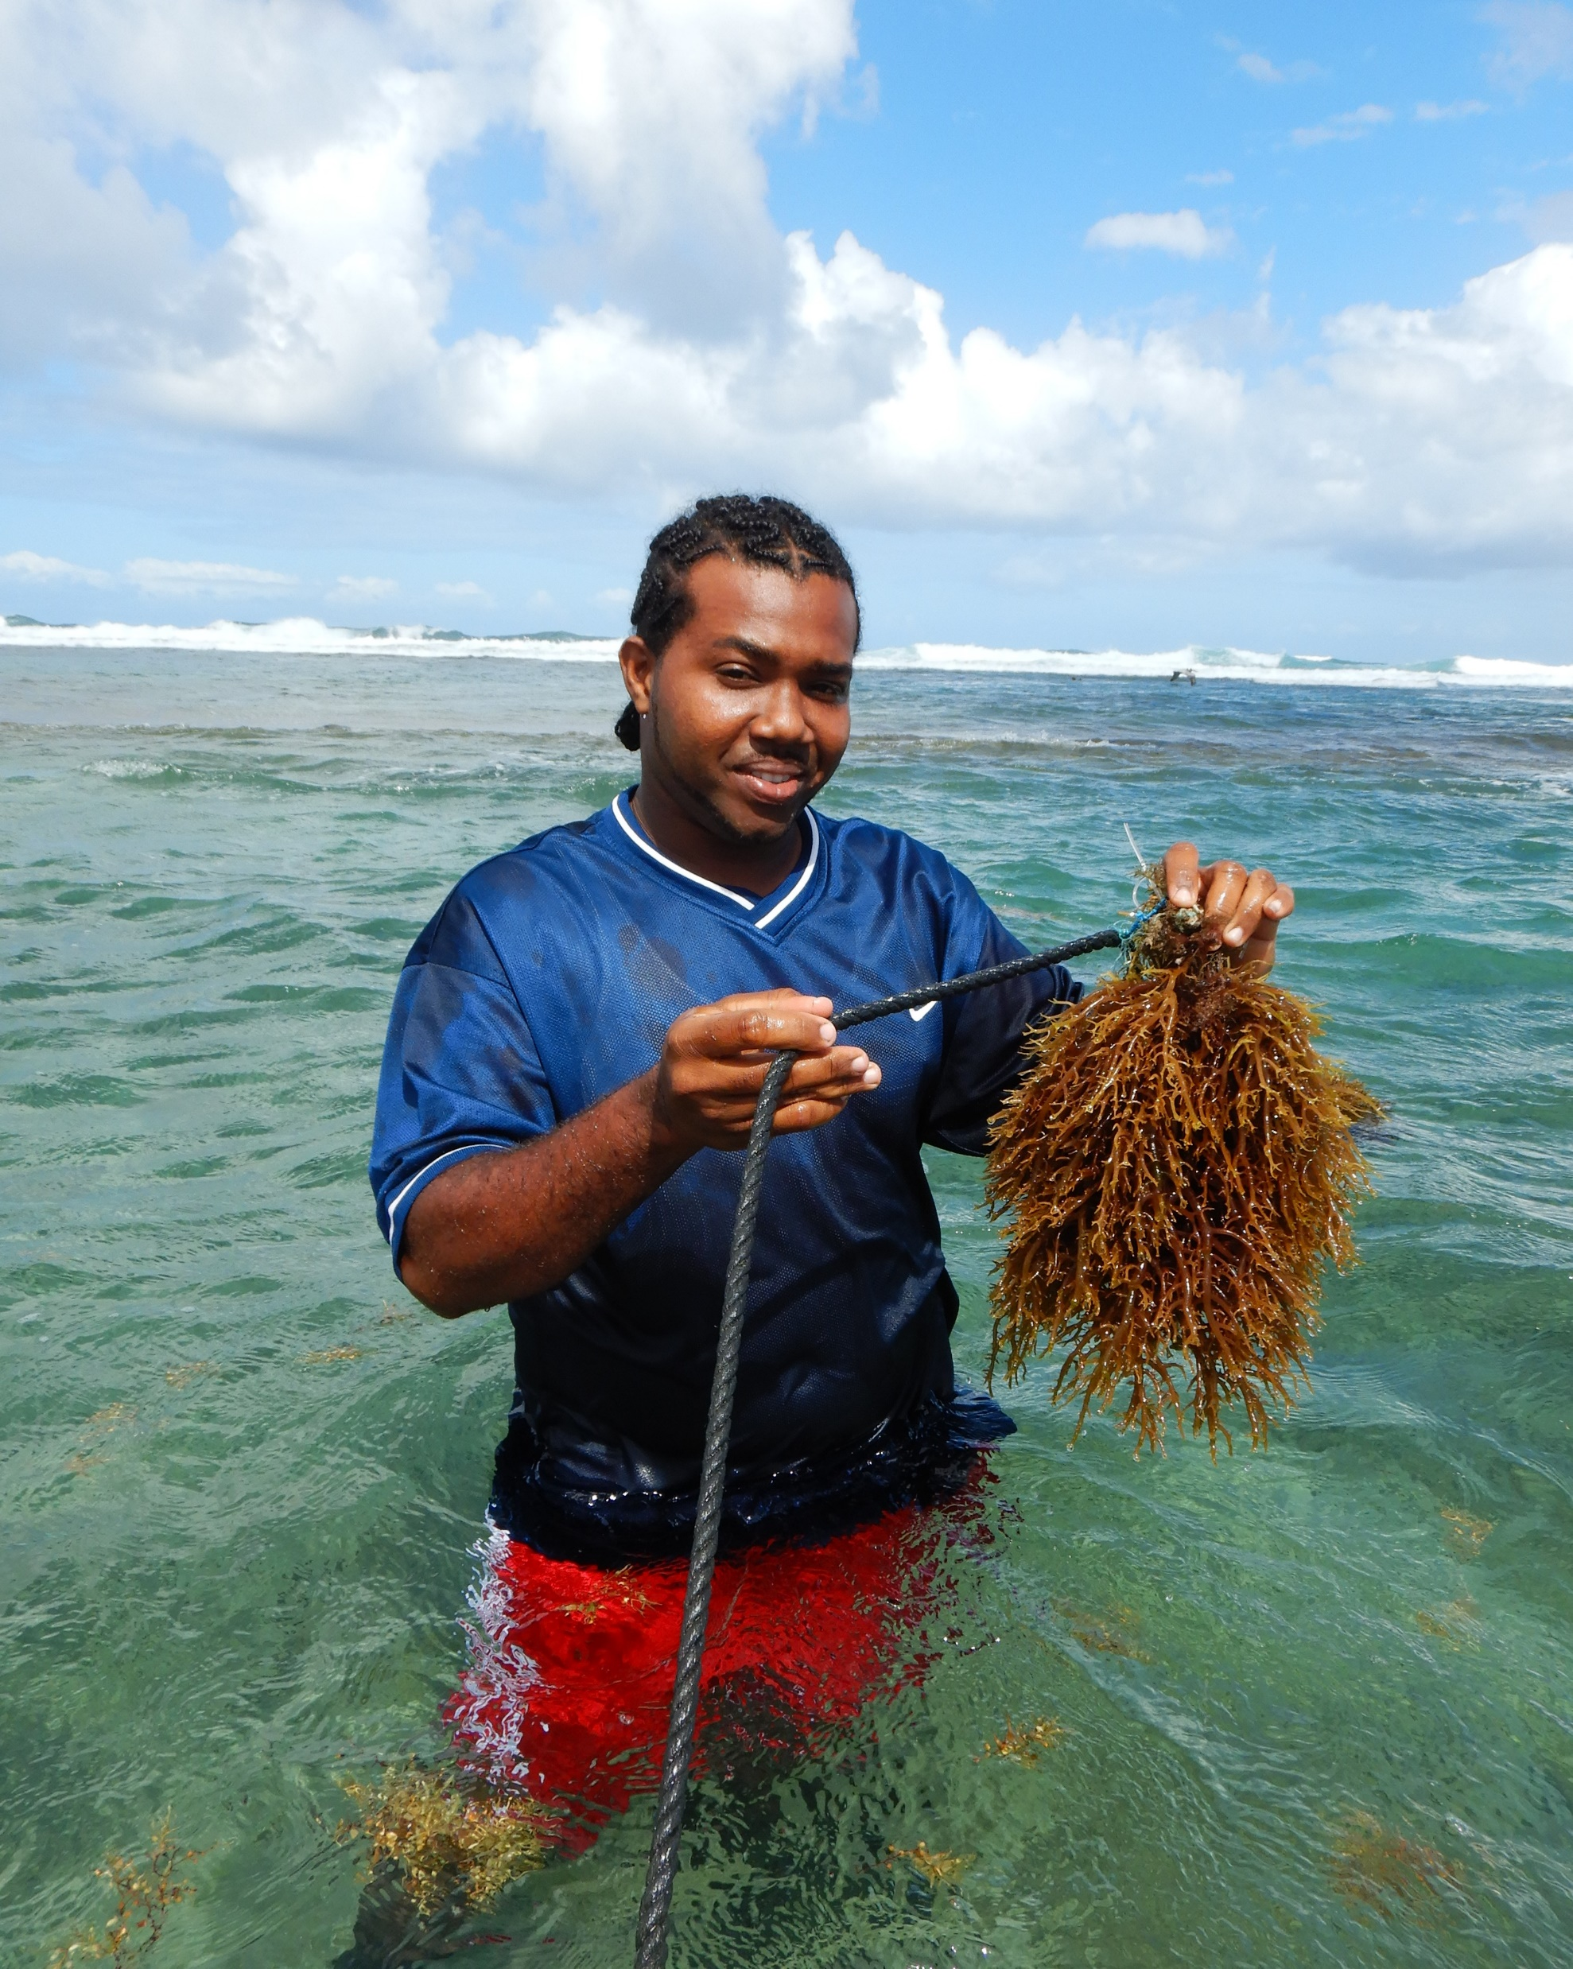
Issues addressed by the project
Although production by the Liamuiga Seamoss Group was done regularly, it was done on a small scale and was based on the availability of the Agro-processing building for use after working hours. In addition, the equipment used for production and labeling was the property of the Agro-processing Unit.
In order to meet the demand for seamoss drinks locally, the group needed to expand its level of operations, reduce the reliance on the Agro-processing Unit, and improve quality assurance as a number of local businesses (supermarkets, village pharmacies and shops) expressed an interest in becoming outlets for Liamuiga Seamoss drink products. Capacity building was required so that the group could effectively operate the business at a higher level.
Awareness of the nutritional properties and potential health benefits of seamoss and the work of the Liamuiga Seamoss Group had been promoted at local fairs. However, the Group wished to increase their visibility in local markets and expand their customer base. There was also the possibility of marketing products outside of domestic markets.
Photo credit: United Nations Food and Agriculture Organization (FAO)//Stankus
Photo credit: FAO//Stankus
Image: Liamuiga Seamoss Group member harvesting Seamoss from their seamoss farm

Slide 7
Project goal
Project objectives
The goal of the Enhancing and promoting the sea moss industry within St. Kitts and Nevis to promote social empowerment and food and nutrition security project was to increase the capacity of the Liamuiga Seamoss Group to successfully manage a small and micro enterprise while meeting the increasing demand for seamoss products.
To expand the Group’s current seamoss farm by increasing the number of plots
To improve the quality assurance of seamoss products and ensure that products comply with Bureau of Standards and Health Department requirements
To build the capacity of the Group’s members in small and micro enterprise development and management and value-added processing
To establish a new facility for seamoss production
To improve marketing of the Group’s seamoss products

Slide 8
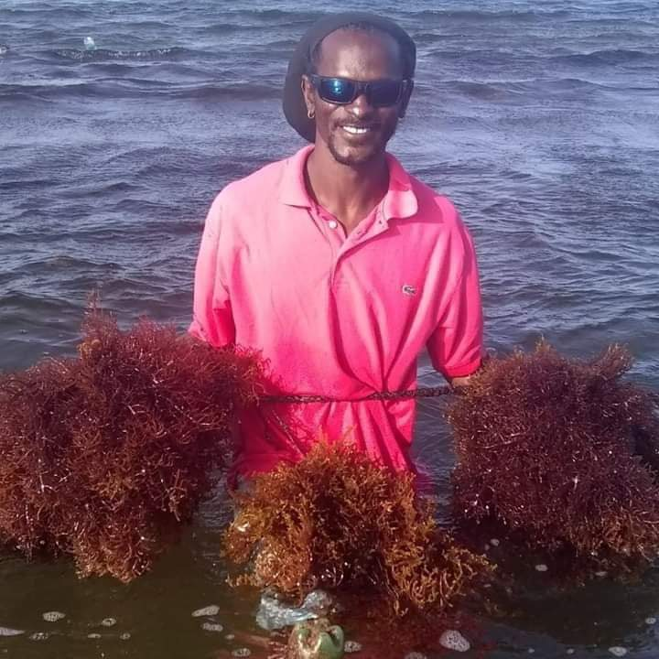
Result 1: Six new seamoss plots established
The Liamuiga Seamoss Group collaborated with the Department of Marine Resources to establish 6 new seamoss plots.
Activities implemented:
Procured materials to develop 6 new seamoss plots
Worked with the Department of Marine Resources to set up 6 new plots
Key results:
6 new seamoss plots
Capacity of the Group built in seamoss cultivation
Photo credit: Liamuiga Seamoss Group
Image: Liamuiga Seamoss Group member harvesting Seamoss from their seamoss farm

Slide 9
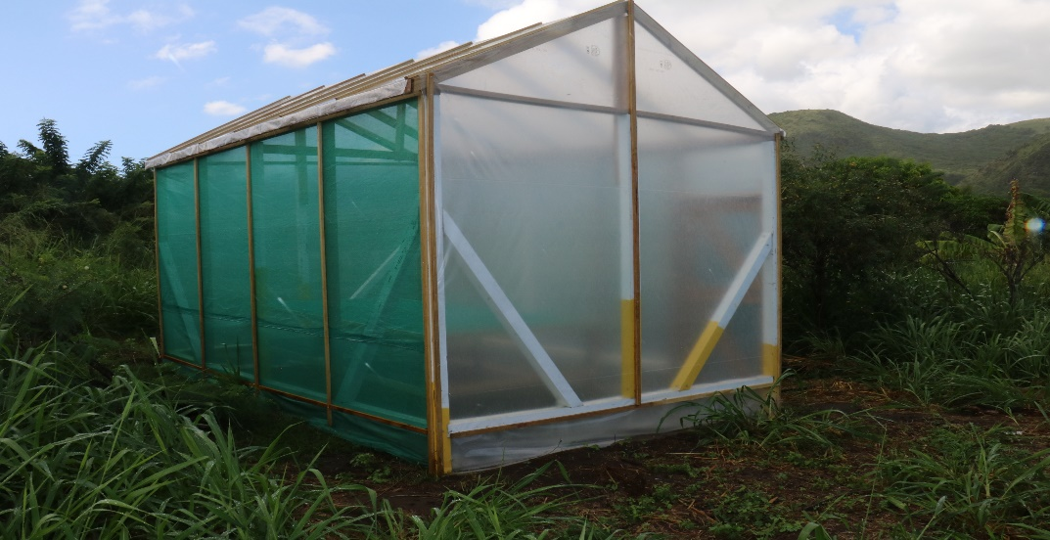
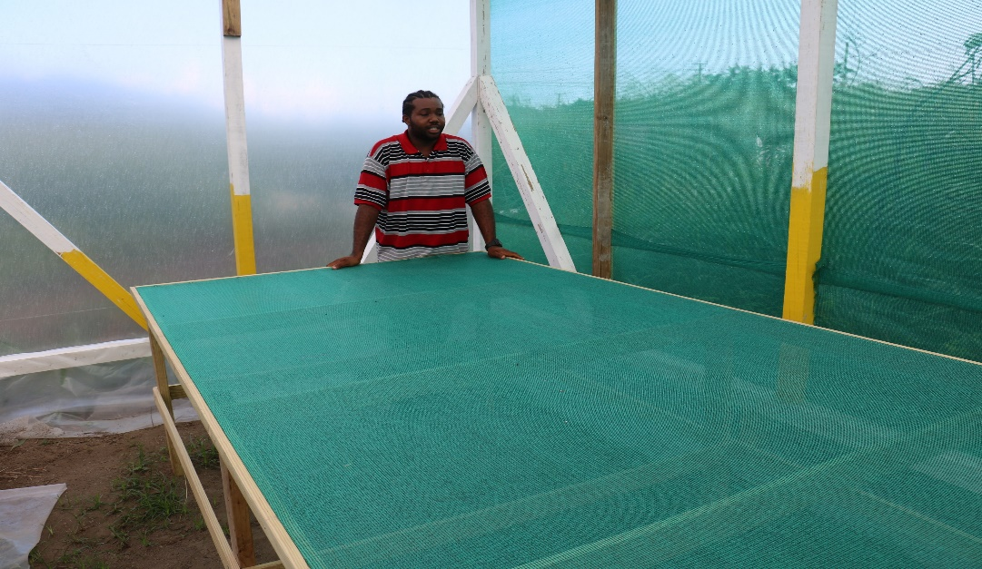
Result 2: Quality assurance of seamoss product improved
The Liamuiga Seamoss Group took key steps to improve the quality assurance of their seamoss drink products including getting their products tested at the Bureau of Standards and constructing a drying house to improve processing (drying) of their seamoss.
Activities implemented:
Had seamoss drink tested and analysed by the Bureau of Standards for yeast and mould and nutritional content
Procured equipment and materials for construction of a drying house
Constructed a drying house to improve drying of seamoss
Procured labelling equipment and materials to update labels with nutritional information
Photo credit: CANARI
Key results:
Improved quality assurance of seamoss drink products through testing
Drying house constructed
Nutritional information available to update new drink labels
Equipment for the Group to create their own new labels
Photo credit: CANARI
Images: New drying house constructed by the Liamuiga Seamoss Group

Slide 10
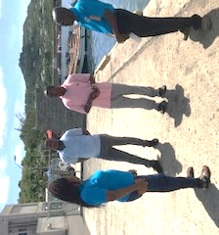
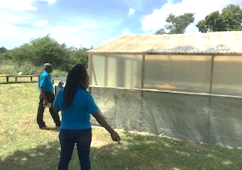
Result 3: Capacity of members built in in small and micro enterprise development and value-added processing
Liamuiga Seamoss Group held two capacity building workshops for members on marketing and value-added processing of ice cream, granola bars, cake, fudge, ice pops and poncho Cuba. Three members also participated in a peer exchange visit to Saint Lucia to learn about the cultivation, processing and marketing of seamoss.
Activities implemented:
Arranged and convened a capacity building workshop on value added products
Arranged and convened a capacity building workshop on marketing
Arranged and participated in a peer exchange to Saint Lucia to learn about the cultivation, processing and marketing of seamoss
Photo credit: Liamuiga Seamoss Group
Key results:
8 members built capacity in marketing of seamoss products
10 members built capacity in value added products
3 members enhanced knowledge of cultivation, processing and marketing of seamoss through peer learning
Photo credit: Liamuiga Seamoss Group
Images: Members of the Liamuiga Seamoss Group on a peer exchange to Saint Lucia

Slide 11
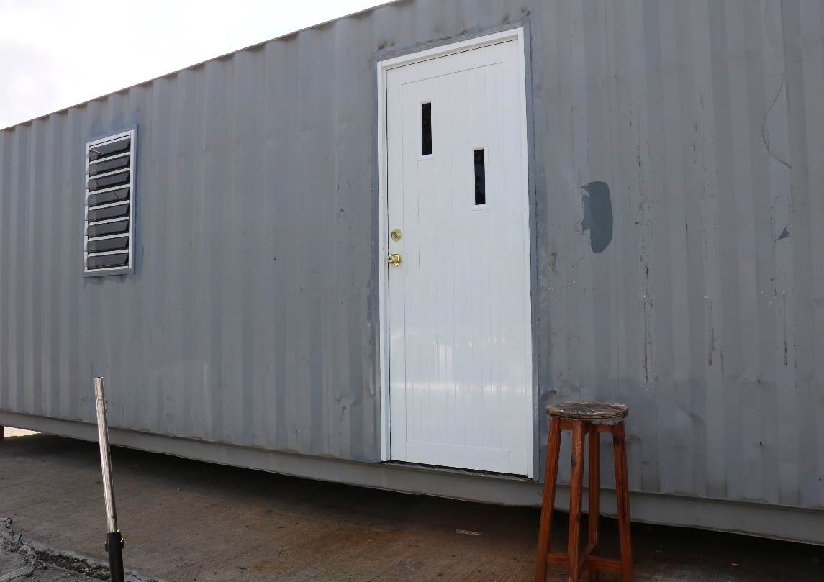
Result 4: New facility for Seamoss production established
The Liamuiga Seamoss Group constructed a new processing facility for their seamoss enterprise.
Activities implemented:
Procured materials and equipment to construct a new facility including an industrial container, refrigerator, industrial processor and stove
Key results:
New processing facility constructed
Reduced reliance on facilities at Agro-processing Unit for production of seamoss products
Photo credit: CANARI
Image: New processing facility constructed by the Liamuiga Seamoss Group

Slide 12
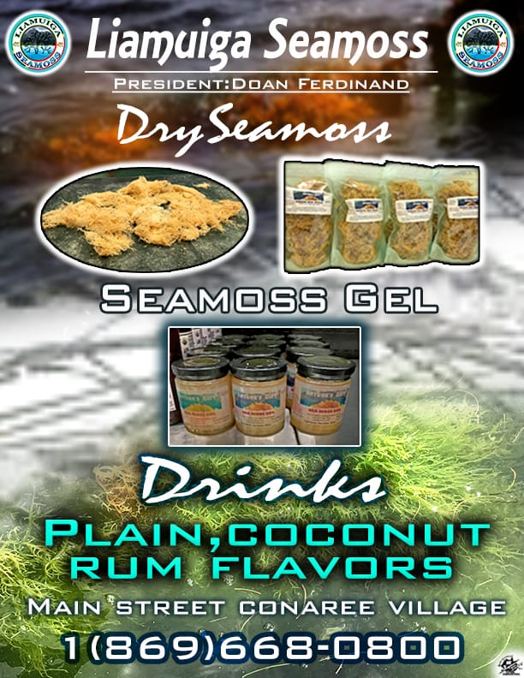
Result 5: Marketing strategy and promotional materials developed
To improve marketing of their seamoss products the Liamuiga Seamoss Group developed a simple marketing strategy and created new promotional materials.
Activities implemented:
Developed a simple marketing strategy (this was done as one of the activities during the small and micro enterprise training workshop)
Designed new promotional materials including an electronic flyer and a banner
Key results:
Simple marketing strategy to guide marketing of the Liamuiga Seamoss Group’s seamoss products
New promotional materials
Image: Liamuiga Seamoss Group’s new promotional flyer

Slide 13
Lessons learned
Challenges
There were challenges with getting the full support of the Group to execute work.
Group members who had previously committed to volunteer time to construct the drying-shed and container were unable to meet this commitment. As a result, project funds had to be reallocated to pay contractors to undertake these works, so that it would be completed within the project period.
Due to periods of bad weather, most of the Group’s seamoss plots were destroyed. As a result, to keep up with production of their seamoss drinks, the Group had to import dry seamoss from Grenada.
Given that the Liamuiga Seamoss Group is relatively new to seamoss harvesting and processing, during the implementation of the project the Group realised that certain equipment and materials that would have been necessary were not budgeted for in their project. As a result, the Group had to make some adjustments to the items set out in their original budget.
Seeking more technical guidance from experts in seamoss cultivation and processing would have helped with ensuring that the right equipment and materials to set up the drying house and processing facility were budgeted for.
Seeking early buy-in and having better communication about the project and its progress with Group members could have improved the commitment of more members to support with implementing the project.

Slide 14
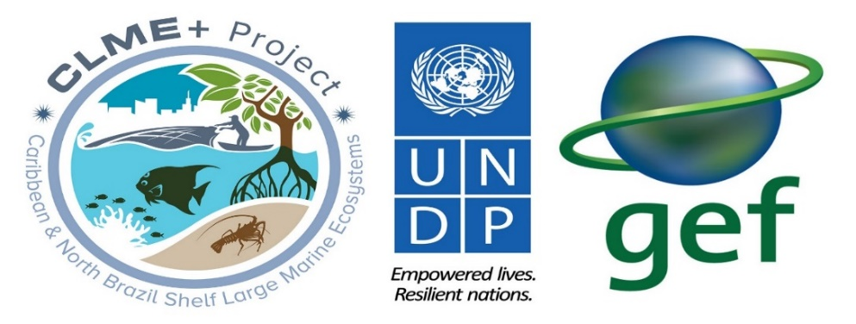
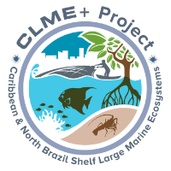
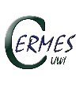
This Information Product was developed under the Engaging Civil Society in CLME+ SAP Implementation project which is being executed by the Caribbean Natural Resources Institute (CANARI) as a component of the CLME+ Project. The five-year (2015 – 2020) CLME+ Project is being implemented by the United Nations Development Programme (UNDP) and co-financed by the Global Environment Facility (GEF).
CLME+ Project co-executing partners:
Disclaimer:
The designations employed and the presentation of information in any format in this Information Product do not imply the expression of any opinion whatsoever on the part of the GEF, UNDP and/or any of the CLME+ Project co-executing partners concerning the legal status of any country, territory, city or area or of its authorities, or concerning the delimitation of its frontiers or boundaries. Unless expressly stated otherwise, the content, facts, findings, interpretations, conclusions, views and opinions expressed in this Information Product are those of CANARI, and publication as a CLME+ Project Information Product does not by itself constitute an endorsement of the GEF, UNDP and/or any of the CLME+ Project co-executing partners of such content, facts, findings, interpretations, conclusions, views or opinions. The GEF, UNDP and/or any of the CLME+ Project co-executing partners do not warrant that the information contained in this Information Product is complete and correct and shall not be liable whatsoever for any damages incurred as a result of its use.
For more information contact CANARI at info@canari.org

